Slide 1
TTP Bridge Update
ITA Annual Meeting
December 7, 2022
Russell Garcia, PE
Bridge Program Manager
Office of Tribal Transportation
Federal Highway Administration

Slide 2
Topics to be Discussed
TTP Bridge Program Funds under the BIL
Bridge Applications Funded in FY22
TTP Bridge Funding in FY23
Bridge Applications Funded to Date
2021 Poor Condition TTP Bridges
Q&As for the TTP Bridge Program under the BIL
Status of the 23 CFR 661 NPRM
Other Items
Notes:
Good afternoon to everyone. Good to see you all again after 3 months
My presentation today will just be an update on the number of applications received and funded to date
Topics discussed last May, I will not repeat these topics except just on the update of number of applications
My counterpart from BIA, Mike Vasquez, will join me in this presentation. He will give us an update on the number of applications received from the Regions. That is after my presentation

Slide 3
TTP Bridge Program Funds - BIL
Tribal Transportation Facility Bridges (TTP Bridges)
  Eliminated 3% Set-aside from TTP
  Bridge Formula Program (BFP) – 3% Set-aside
    $165M/year (General Fund)
  Bridge Investment Program (BIP) Set-aside
    $20M/year (General Fund)
  Bridge Investment Program (BIP) Set-aside
    FY22 $16M (Highway Trust Fund)
    FY23 $18M (Highway Trust Fund)
    FY24 $20M (Highway Trust Fund)
    FY25 $22M (Highway Trust Fund)
    FY26 $24M (Highway Trust Fund)
  Please submit your bridge applications! Coordinate with the BIA Regions or FHWA TCs!

Slide 4
Bridge Applications Funded in FY22
BIA owned bridges – 20 applications at $22.5M
Tribally owned bridges – 9 applications at $11.9M
Non-BIA/Non-Tribally owned bridges – 20 applications at $7.1M
Total of 49 applications funded at $41.5M
FHWA Tribes – 25 applications funded at $32.3M
BIA Tribes – 24 applications funded at $9.2M
BFP Funds obligated/expended in FY22 - $41.5M
Funds available in FY22 - $165M (BFP); $20M (BIP); $14.6M (BIP)
BFP Funds unobligated in FY22 – $123.5M
Please submit bridge applications!!

Slide 5
TTP Bridge Funding in FY23
FY23 BFP Funds (GF): $123.5M (FY22) + $165M = $288.5M
FY23 BIP Funds (GF): $20M (FY22) + $20M = $40M
FY23 BIP Funds (HTF): $14.6M (FY22) + $18M (without the lop-off rate) = $30.8M (assuming 10% lop-off rate)
Total Funds available in FY23: $359M+/-

Slide 6
Bridge Applications Funded to Date
No. | BIA Region / FHWA Tribe/ DOT Self Governance | Owner | NBI # | Tribal Nation | Funds Requested | CN/PE
1 | Southern Plains Region | Non-BIA | 62130000000000 | Kickapoo Tribe of OK | $340,000.00 | CN
2 | Southern Plains Region | Non-BIA | 115440000000000 | Kickapoo Tribe of OK | $256,000.00 | CN
3 | Southern Plains Region | Non-BIA | 048070000000000 | Kickapoo Tribe of OK | $340,000.00 | CN
4 | Midwest Region | BIA | F905 | Menominee | $75,000.00 | PE
5 | Midwest Region | BIA | F906 | Menominee | $75,000.00 | PE
6 | Western Region | BIA | H020 | Colorado River Indian Tribes | $235,000.00 | PE
7 | Western Region | BIA | H027 | Colorado River Indian Tribes | $235,000.00 | PE
8 | Eastern Oklahoma Region | Non-BIA | 10402000000000 | Muscogee (Creek) Nation | $84,000.00 | PE
9 | Eastern Oklahoma Region | Non-BIA | 11215000000000 | Muscogee (Creek) Nation | $83,000.00 | PE
10 | FHWA Tribe | Tribal | TS663 | Catawba | $1,594,800.62 | CN
11 | FHWA Tribe | BIA | C106 | Blackfeet Nation | $150,000.00 | PE
12 | FHWA Tribe | BIA | C107 | Blackfeet Nation | $150,000.00 | PE
13 | FHWA Tribe | BIA | C120 | Blackfeet Nation | $150,000.00 | PE
14 | FHWA Tribe | BIA | C130 | Blackfeet Nation | $150,000.00 | PE
15 | FHWA Tribe | BIA | M123 | Acoma Pueblo | $137,049.00 | PE
16 | FHWA Tribe | BIA | M124 | Acoma Pueblo | $380,000.00 | PE
17 | DOT Self-Governance | Non-BIA | 07504 | Cherokee Nation | $1,000,000.00 | CN
 |  |  |  |  | $5,434,849.62

Slide 7
2021 TTP Bridges in Poor Condition
2021 NBI Data
Owner Code | Total Number of TTP Bridges | TTP Bridges in Poor Condition | Improvement Cost
BIA - 62 | 1,016 | 87 | $120,000,000
Tribal - 61 | 120 | 24 | $45,000,000
County - 2 | 4,239 | 628 | $290,000,000
State - 1 | 1,886 | 77 | $120,000,000
City/Municipal - 4 | 350 | 38 | $55,000,000
TOTAL | 7,611 | 854 | $630,000,000
Notes:
.

Slide 8
Q&As TTP Bridge Program - BIL
Did BIL make any changes to the TTP Bridge Program?
Yes. BIL modified 23 U.S.C. 202(d) to update outdated terminology and broaden eligibility with respect to new bridges. Also, BIL eliminated the 3 percent set aside from the TTP (23 U.S.C. 202) and, instead, sets aside funding for the TTP Bridge Program from other authorized or appropriated programs.
Tribal Transportation Program (TTP) - Bridge Program Questions and Answers (Q&As) | FHWA (dot.gov)

Slide 9
Q&As TTP Bridge Program - BIL
What are the periods of availability for the obligation and expenditure of the available funds?
For BFP Funds ($165M) and BIP Funds ($20M):

Slide 10
Q&As TTP Bridge Program - BIL
What kinds of bridges are eligible for this funding?
For bridge replacement or rehabilitation:
(a) have an opening of 20 feet or more;
(b) be classified as a Tribal transportation facility;
(c) be classified as in poor condition, have low load capacity, or need geometric improvements; and
(d) be recorded in the National Bridge Inventory (NBI) maintained by the FHWA.
For new bridge construction:
(a) classified as a Tribal transportation facility;
(b) a public bridge with opening of 20 feet or more; and
(c) recorded in the NBI after project completion.

Slide 11
Q&As TTP Bridge Program - BIL
What are the application processes for submitting a bridge application?
Any time during the fiscal year, a Tribe may prepare and submit to the BIA Region or FHWA Tribal Coordinator (TC) an application package to request TTP Bridge Program funding. The BIA Region or FHWA TC will assist the Tribe in preparing the application package, review the Tribe’s submittal and resolve any issues with the Tribe.
For Tribes with FHWA Program Agreements, the FHWA TC will submit the completed bridge application package directly to the TTP Bridge Program Manager at the FHWA/Office of Tribal Transportation (OTT) for review of the application.

Slide 12
Q&As TTP Bridge Program - BIL
For Tribes working directly with the BIA, the BIA Region will submit the completed bridge application package to the BIA Bridge Program Manager for review. Upon review and resolution of any issues with the bridge application, BIA will submit the completed bridge application package directly to the TTP Bridge Program Manager at OTT for further processing and consideration.

Slide 13
Q&As TTP Bridge Program - BIL
What does a complete application package for preliminary engineering (PE) consist of and how does the proposed project receive funding?
A complete application package for PE consists of:
(a) the TTP Bridge Program certification checklist;
(b) an FHWA approved TTP Tribal Transportation Improvement Program;
(c) a description of the project scope of work;
(d) detailed cost estimate for PE;
(e) NBI data sheet (n/a for new bridge); and
(f) an acknowledgment by the Tribe of the project specific funding requirements and that any excess funds will be returned to FHWA for further distribution.

Slide 14
Q&As TTP Bridge Program - BIL
Funding for the approved eligible projects on the bridge application queues will be made available to the Tribes, under an FHWA/Tribal agreement, or the Secretary of the Interior upon availability of program funding at FHWA.
For non-BIA/non-Tribal TTP bridge projects funded under the TTP Bridge Program, the application package must also include a Tribal resolution supporting the project.
These requirements are provided for in 23 CFR 661.25.

Slide 15
Q&As TTP Bridge Program - BIL
What does a complete application package for construction consist of and how does the proposed project receive funding?
A complete application package for construction consists of:
(a) a copy of the approved plans, specifications, and estimate (PS&E);
(b) the TTP Bridge Program certification checklist;
(c) NBI data sheet (n/a for new bridge);
(d) an FHWA approved TTP Tribal Transportation Improvement Program;
(e) all environmental and archeological clearances and complete grants of public rights-of-way that must be acquired prior to submittal of the construction application package; and
(f) an acknowledgment by the Tribe of the project specific funding requirements and that any excess funds will be returned to FHWA for further distribution.

Slide 16
Q&As TTP Bridge Program - BIL
Funding for the approved eligible projects on the bridge application queues will be made available to the Tribes, under an FHWA/Tribal agreement, or the Secretary of the Interior upon availability of program funding at FHWA.
For non-BIA/non-Tribal TTP bridge projects funded under the TTP Bridge Program, the application package must also include a copy of a letter from the bridge’s owner approving the project and its PS&E, and a Tribal resolution supporting the project.
These requirements are provided for in 23 CFR 661.27.

Slide 17
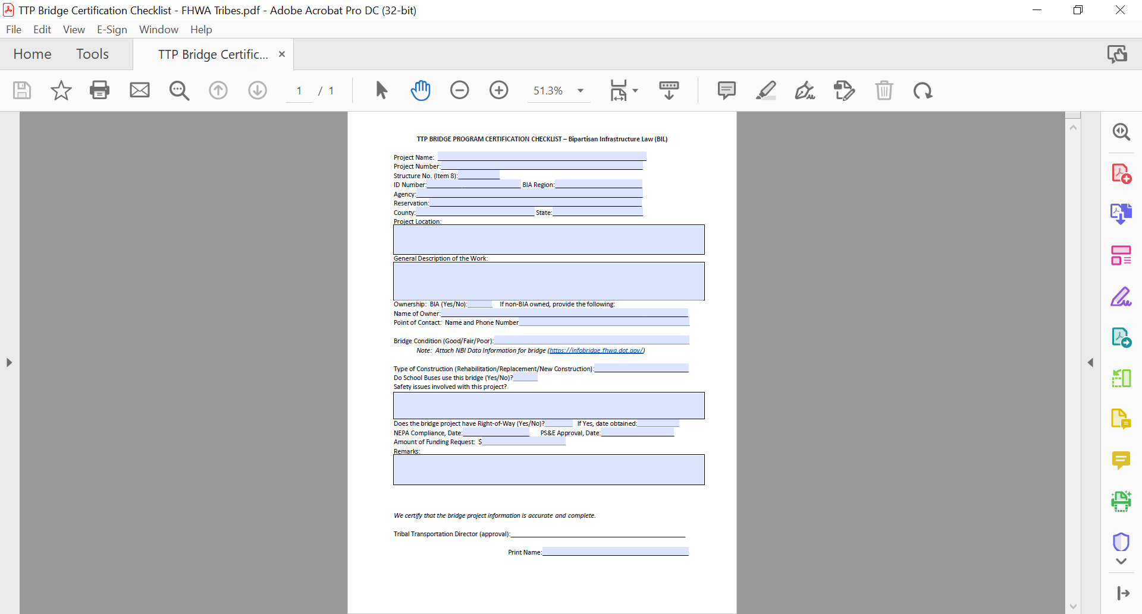
Other Items

Slide 18
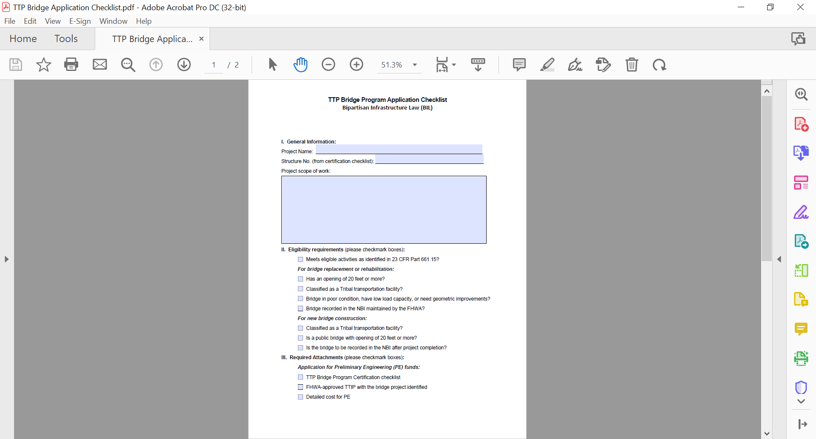
Other Items

Slide 19
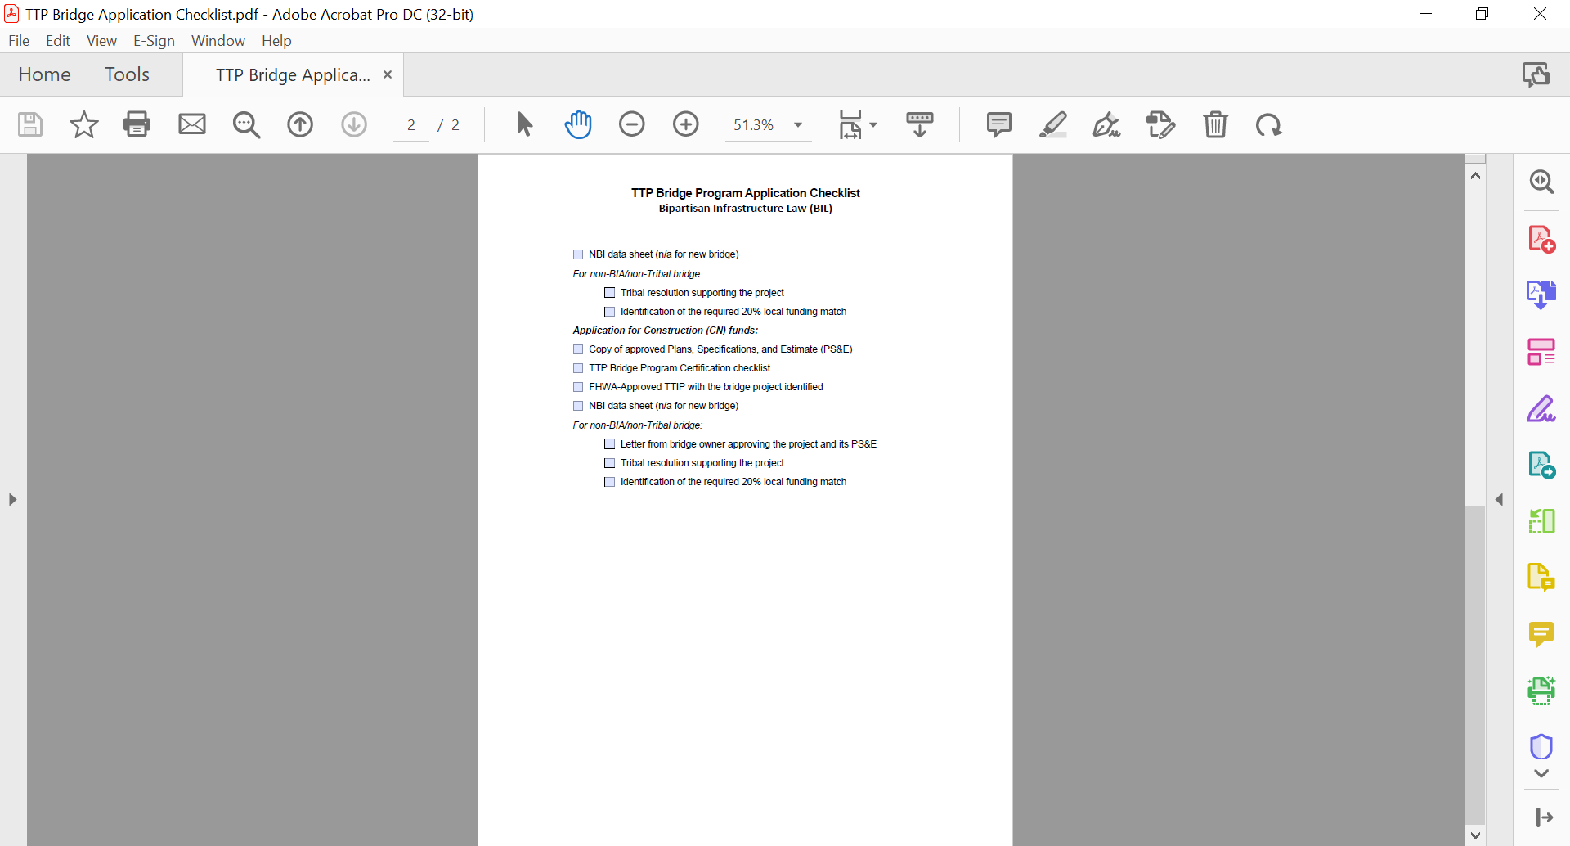
Other Items

Slide 20
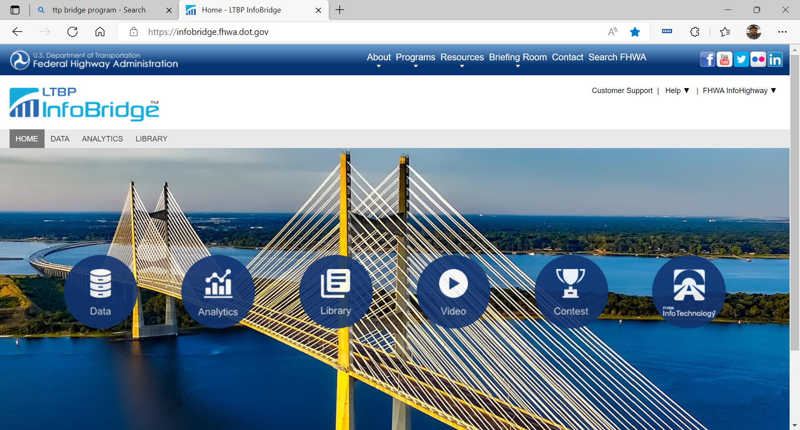
Other Items

Slide 21
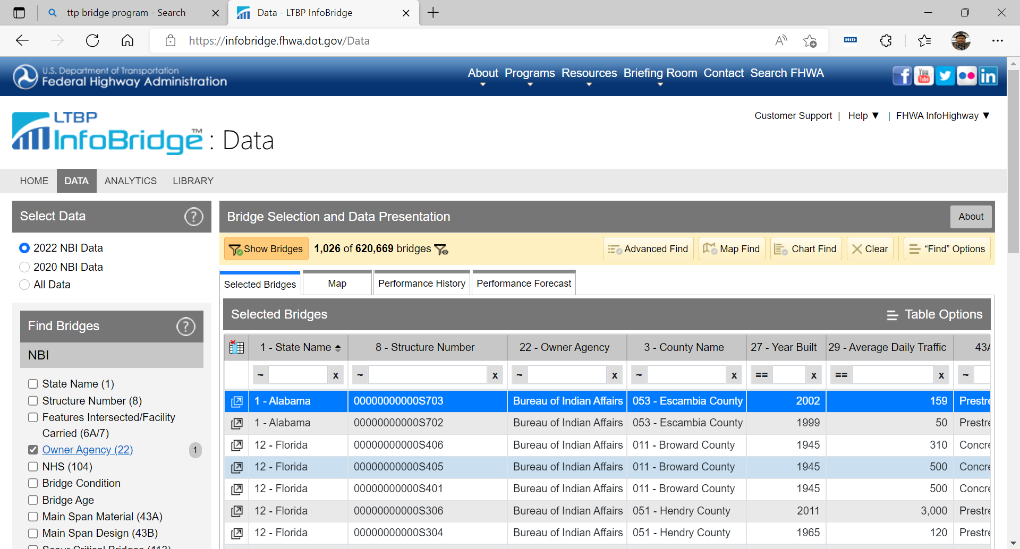
Other Items

Slide 22

Other Items

Slide 23
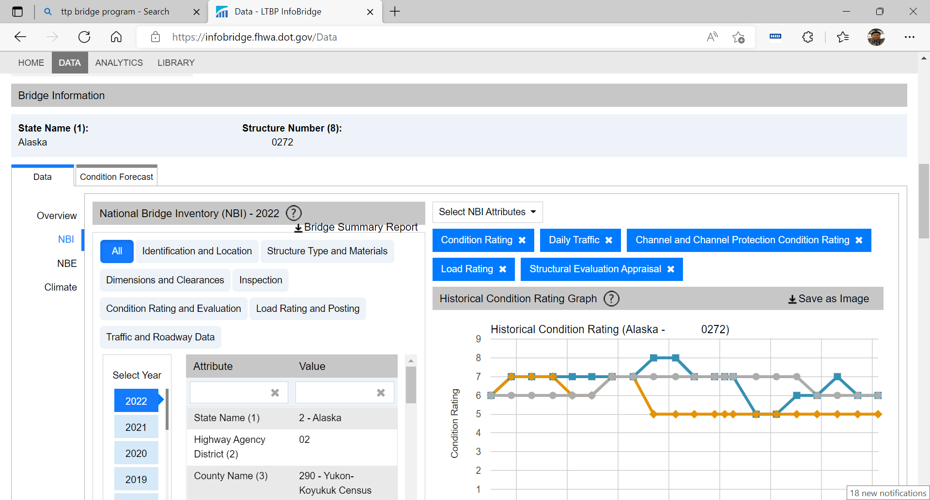
Other Items

Slide 24
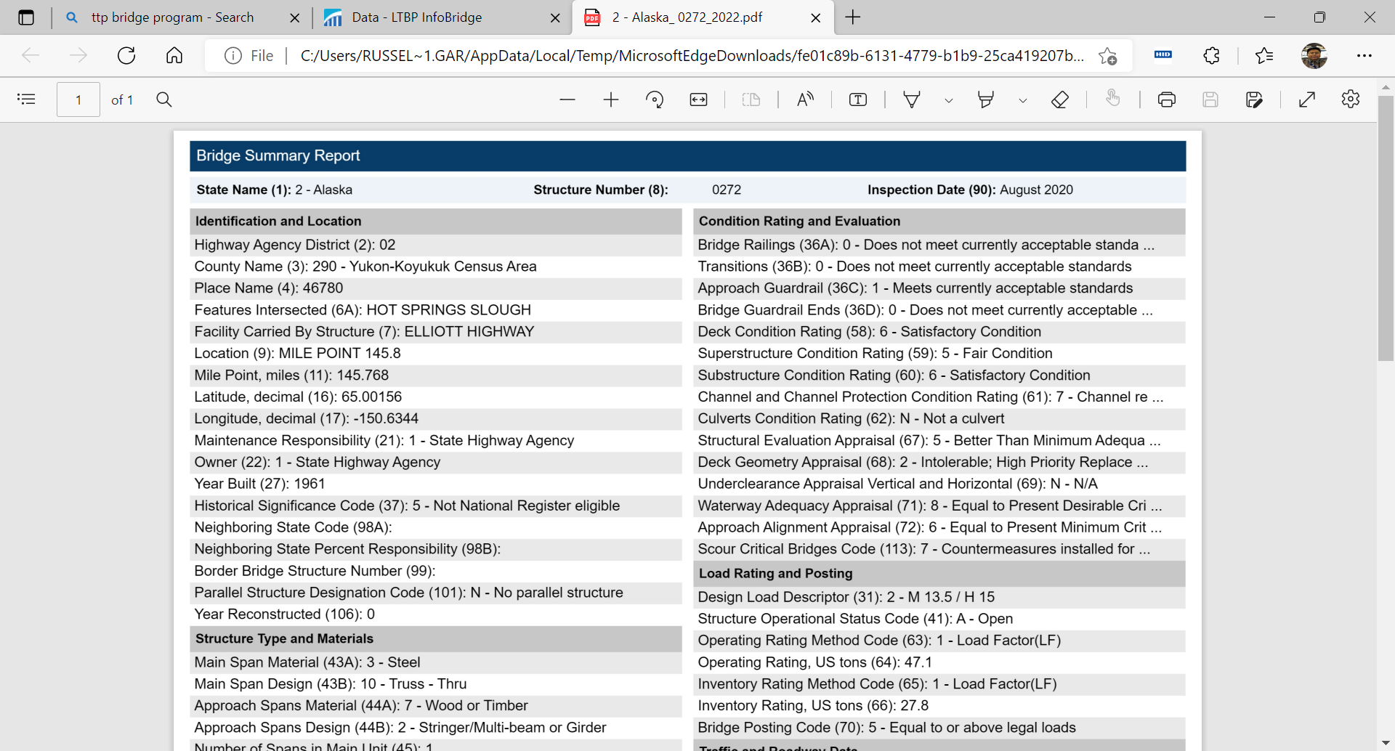
Other Items

Slide 25
23 CFR 661 NPRM Update
The draft NPRM was initially approved by FHWA
The draft NPRM was updated to include the changes from the BIL
The draft NPRM is back for review and approval by FHWA
Planned Publication Date in the Federal Register: ???

Slide 26
Other Items
Roll outs of the TTP Bridge Program under BIL:
  ITCA Virtual Meeting, March 2022
  AK Providers Virtual Meeting, April 2022
  TTPCC Meeting in ABQ, May 2022
  ITA Virtual Meeting, June 2022
  USET Virtual Meeting, July 2022
  TTPCC Meeting in ID, August 2022
  NTICC Meeting KY, August 2022
  AK Providers Conference, Nov. 2022
  ITA Meeting in Las Vegas, Dec. 2022

Slide 27

Questions??

