Slide 1
Road Inventory Field Data System (RIFDS) Tribal/Contractor Access Training
Bureau of Indian Affairs – Office of Indian Services
Division of Transportation (BIADOT)
August 15 – August 17, 2023
National Indian Program Training Center (NITPC)
Albuquerque, NM

Slide 2
Instructors
Sheldon O. Kipp - BIADOT (ABQ)
Aldon Francisco - BIADOT (ABQ)
Christopher Becenti – BIADOT (ABQ)
BIA-OIS–Division of Transportation
Albuquerque, NM

Slide 3
Agenda
DAY 1
8:30a – 9:00a Introductions, Agenda review
9:00a – 10:00a Subjects: Background, Evolution, Process, IT system
10:00a – 10:15a Break
10:15a – 11:00a Subjects: Permissions, Access, Roles, Privileges
11:00a – 11:45a Training: intent/basics/orientation
11:45a – 1:00p Lunch
1:00p – 2:15p New regulatory requirements (subpart D)
2:15p – 3:15p “Correcting” a Facility (road & bridge section)
3:15p – 3:30p Break
3:30p – 4:30p “Correcting” a Facility (road & bridge section)

Slide 4
Agenda
DAY 2
8:30a – 9:00a Review Day 1
9:00a – 10:15a “Updating” a Legacy or RIFDS-ready record
- ‘age of your inventory’
- discuss ‘grandfathered-in’ routes
10:15a – 10:45a Break
10:45a – 11:45a Delete a Route/Section
Renumber/Resection a Route
Direct-to-Official updates
11:45a – 1:00p Lunch
1:00p – 2:30p “Adding” a new Route/Facility
2:30p – 2:45p Break
2:30p – 3:30p continued “Adding”

Slide 5
Agenda
DAY 3
8:30a – 9:00a Review the 442(e), 444(a), 444(b) implementation
9:00a – 9:30a Identify the data that can be changed thru “corrections”
(i.e.-functional classifications, construction need, other fields)
9:30a – 10:00a Identify situations that can be changed thru “updates”
10:00a – 10:15a Break
10:15a – 11:30a Identify situations that can be changed thru “updates”
11:30a – 12:00p Discuss 170.447, Access Roads
12:00a – 1:15p Lunch
1:15p – 2:30p Discuss the “ArcGIS Initiative”
2:30p – 4:00p Discuss the current TTP formula

Slide 6
Training Subjects
Background of the TTP (formerly IRR program)
Road Inventory Evolution
Ways that RIFDS Improved the Road Inventory Process
Access to a Federal IT System (ITIMS)
User Accounts: Access, Roles, Privileges
Training
RIFDS Wrap-up
Where to Go for HELP

Slide 7
Background of the Tribal Transportation Program (TTP)
The IRR Program was established on May 26, 1928 by Public Law 520, 25 U.S.C. 318(a).
It authorized the Secretary of Agriculture (which had responsibility for Federal roads at the time) to cooperate with state highway agencies and the DOI to survey, construct, reconstruct, and maintain Indian reservation roads serving Indian lands.
In 1982, under the Surface Transportation Assistance Act of 1982 (STAA), Public Law 97-424, Congress created the Federal Lands Highway Program (FLHP).
This coordinated program addresses access needs to and within Indian and other Federal lands. The IRR program was a funding category of this program.

Slide 8
Background of the Tribal Transportation Program (TTP)
Highway Bills:
ISTEA: Intermodal Surface Transportation Equity Act 1992 - 1997
TEA-21: Transportation Equity Act for the 21st Century 1998 - 2003
(One-year extension) 2004
SAFETEA-LU: Safe, Accountable, Flexible, Efficient
Transportation Equity Act: A Legacy for Users 2005 - 2009
(Continuing resolutions – 3 full years) 2010 - 2012
MAP-21: Moving Ahead for Progress into the 21st Century 2013 - 2014
- IRR program renamed > > Tribal Transportation Program
- New statutory formula
(One-year Extension) 2015
FAST ACT : Fixing America’s Surface Transportation Act 2016 – 2020
- Funding from $465m to $505m
(One-year Extension) 2021
STRA-21 : Surface Transportation Reauthorization Act of 2021 2022 – 2026
- Funding from $578m to $627m
- Re-establish the ‘Tribal High Priority Program’

Slide 9
Road Inventory Evolution
1980’s thru 1990’s - Paper “5704” Forms
March 2004 - Initiate RIFDS (Maintenance Release 1 - MR1)
November 2004 - then “New Rule” in effect
February 2005 - RIFDS (MR2), April 2005 – RIFDS (MR3)
October 2007 - RIFDS available on the Internet
December 2016 - Newest Regulations in effect
July 2019 - partial “Implementation” – 443 to 446
August 2023 - “Implementation” discussion at TTPCC level – 447 Access Roads
Changes:
Shift from paper process to on-line software tool (RIFDS)
Adoption of 2004 IRR Program Regulations
Implementation of the “newest” regulations

Slide 10
Ways that RIFDS Improved the Road Inventory Process
Improves transparency at all levels.
Reduces delays in data processing and maintenance funding;
Makes essential data and attachments electronically available to users
Approval rate for road inventory updates has already risen from under 10% to about 50% !

Slide 11
Access to Federal IT Systems (ITIMS)
Requirements:
Personnel Security background check required
– initiated by submitting an eQIP form to BIADOT
Establish eProfile in Identity Information System (IIS)
Certified training & testing for “Systems access”
RIFDS user account establishment/sent to new User
Internet access: https://itims.bia.gov

Slide 12
Access to Federal IT Systems (ITIMS)
Personnel Security background checks
National Agency Checks Inquiry (NACI) – “paper type” investigation
Non-Sensitive/Low Risk level
Lowest level of investigation – review of forms submitted
FBI Fingerprint adjudication
Contacting of references
eAPP form submitted to BIADOT for submittal to OPS
Questions: ia_personnel_security_bia_eqip@bia.gov
Mailing Address: Office of Personnel Security
1011 Indian School Rd. NW, Room 157
Albuquerque, NM 87104
Cost of background check beared by BIADOT

Slide 13
Access to Federal IT Systems (ITIMS)
Establish eProfile in Identity Information System (IIS)
IIS is an IT database designed to manage/track the access of individuals to Indian Affairs information systems
All tribal employees & contractors must have an account with accurate & current employee info, along with the applicable “systems” approvals
All eProfile accounts must have a “Supervisor/Government Approver”
For the requests on the ITIMS environment:
Government Approver (POC) - Sheldon Kipp (505) 563-3320

Slide 14
Access to Federal IT Systems (ITIMS)
3. Certified Training:
2023 Information Management & Technology (IMT) Awareness Training (Streaming Version)
Training accessible via
https://www.doi.gov/doitalent/training-download
Send BIADOT the resultant certificate
DOI Talent Customer Support Center: 1-888-367-1622, HRMS_Helpdesk@ios.doi.gov

Slide 15
Access to Federal IT Systems (ITIMS)
RIFDS user account establishment
UserID/Password (Public User Request Form)
Fill out and submit to BIADOT for approval:
Fax: (505) 563-3046 or,
Scan/send to:
sheldon.kipp@bia.gov
minerva.chavez@bia.gov
“Authorizing Officials” signature block is for tribal administration acknowledgement
RIFDS website: https://itims.bia.gov/

Slide 16
USER ACCOUNT PERMISSIONS
Unique Tribal data access
User restricted to Tribal specific data only
Consultants designated by Tribal Government Authorization
User account Roles

Slide 17
User Account Roles
System Administrators
BIADOT
Region
Field
Browser
Type and Authority of Changes
(account privilege levels)

Slide 18
Account Privilege Levels are Cumulative
Browse Users
View reports
Have authority to:

Slide 19
Account Privilege Levels are Cumulative
Field Users
Use forms to change routes and sections, also initiate renumber/delete requests
Have authority to:
View reports

Slide 20
Account Privilege Levels are Cumulative
Region Users
Have authority to:
Use forms to review submittals from field users and assess the renumber/delete requests
Use forms to change routes and sections, also initiate renumber/delete requests
Use forms to change routes and sections, also initiate renumber/delete requests
View reports
View reports

Slide 21
Account Privilege Levels are Cumulative
BIADOT Users
Have authority to:
Use forms to approve changes and replace the official record
Use forms to review submittals from field users and assess the renumber/delete requests
Use forms to change routes and sections, also initiate renumber/delete requests
Use forms to change routes and sections, also initiate renumber/delete requests
View reports
View reports

Slide 22
Account Privilege Levels are Cumulative
System Administrators
Have authority to:
Change Configuration of RIFDS
Use forms to approve changes and replace the official record
Use forms to review submittals from field users and assess the renumber/delete requests
Use forms to change routes and sections, also initiate renumber/delete requests
View reports

Slide 23
Training
What you will Learn
Log-in Procedures
Basic Navigation thru RIFDS
‘Changes’ to the Database
Processes
Attachments
Other Topics

Slide 24
What you will Learn
After this session, you will know how to:
Access RIFDS at your role level
Navigate thru RIFDS
Change and enter information relating to routes and sections
Better understanding of attachment requirements
Use various features
Export information from RIFDS to a file that can be used in another application (text file)
Access and view reports

Slide 25
Log-In Procedures
Username : studentxx
Password : studentxx
Database : itimst

Slide 26
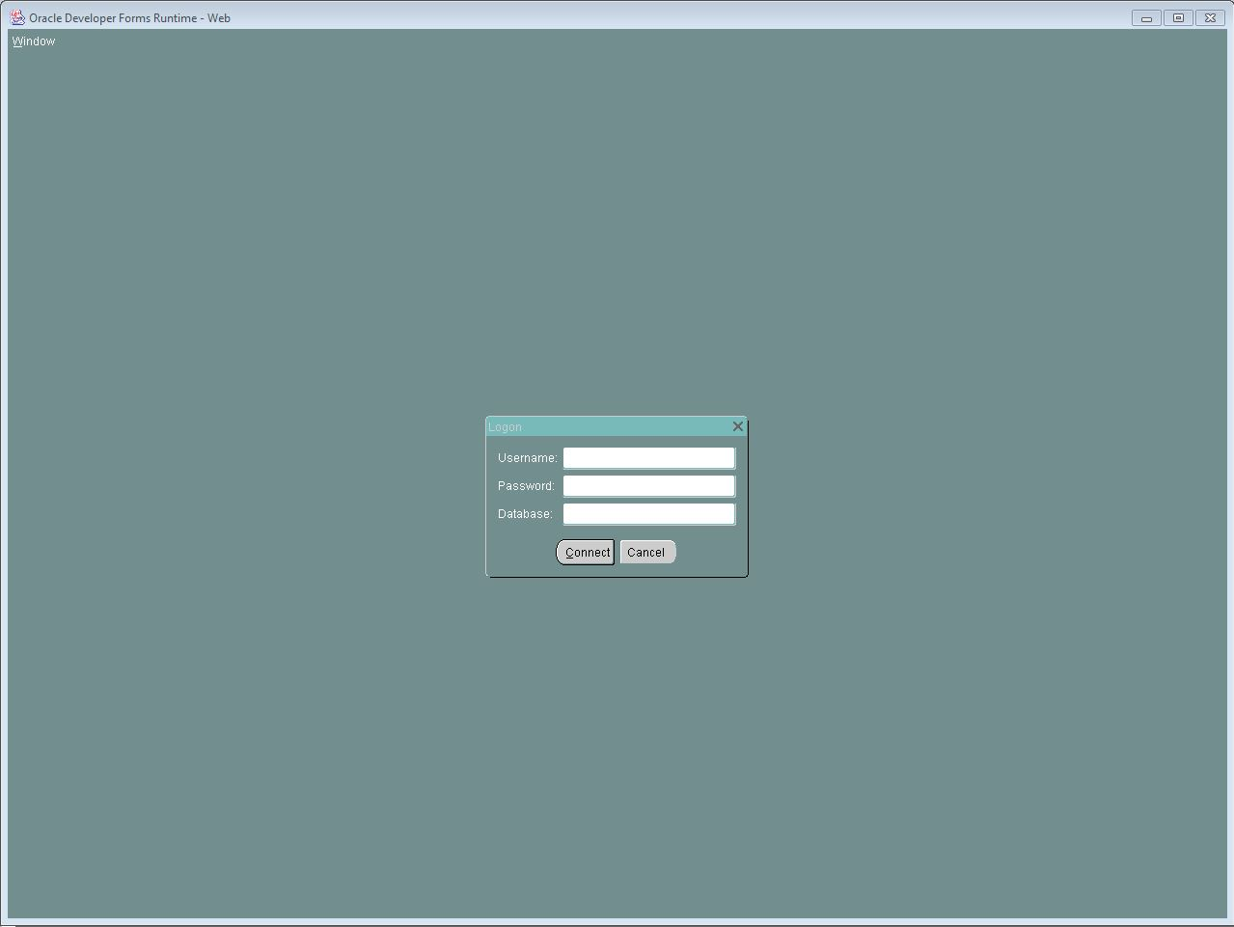
LOGON BOX WILL APPEAR
Enter: Username, Password, Database
Click “Connect”

Slide 27
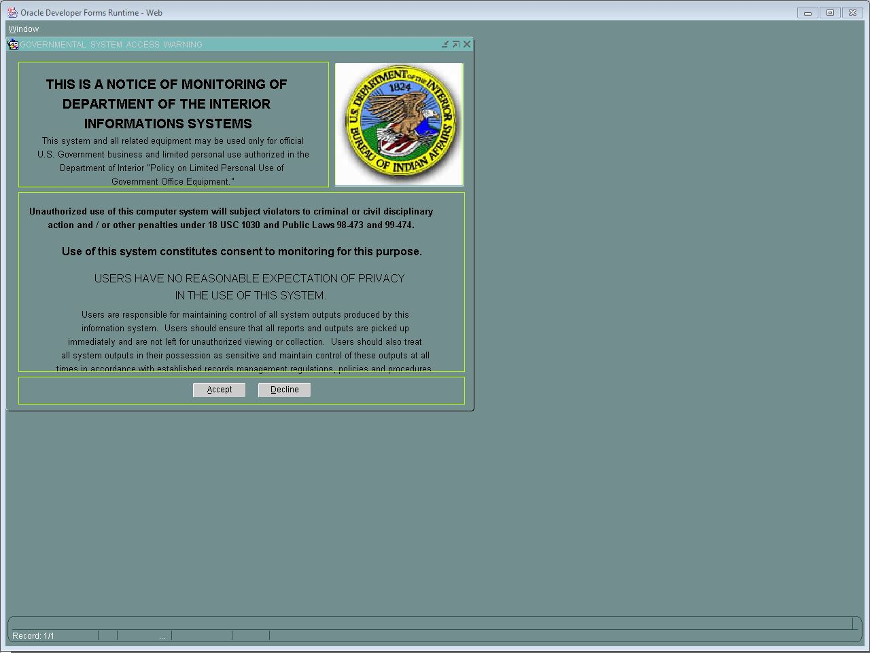

Slide 28
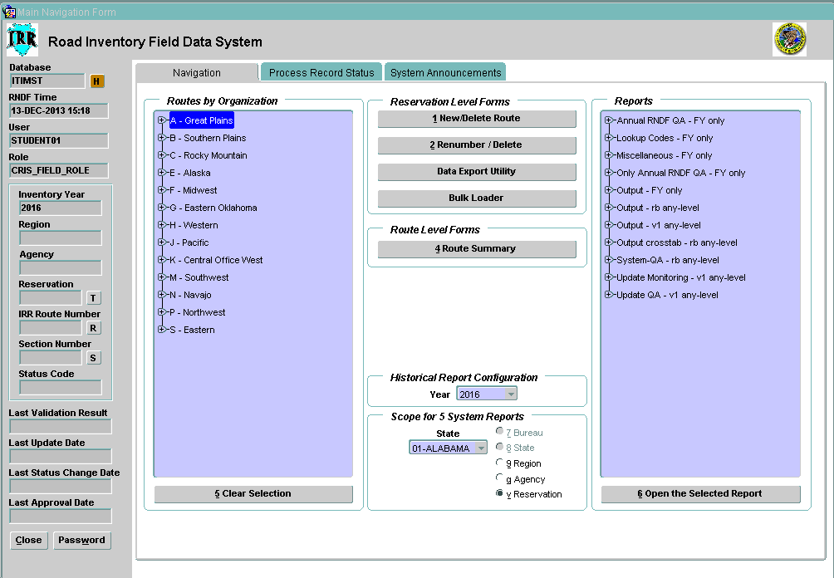
What you will see after Logging On

Slide 29
Basic Navigation thru RIFDS
The following screen shots will be used to reference
The Vertical Tool Bar
Attachments Levels
Help Library/Help Library Screen
Main Navigation Tabs
Logging Off

Slide 30
Basic Navigation – Vertical Tool Bar

Slide 31
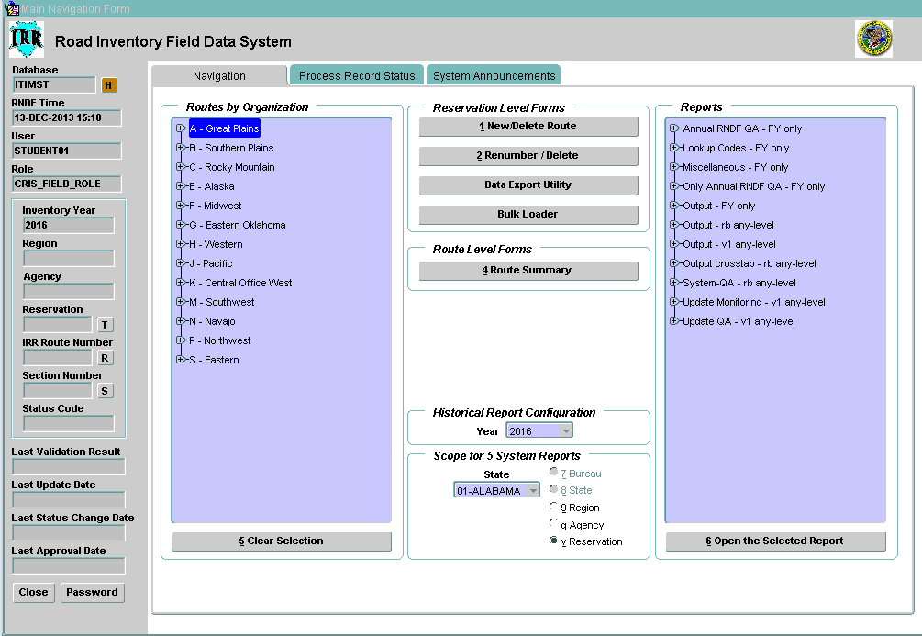
Basic Navigation – Attachments Levels

Slide 32
Basic Navigation – Help Library

Slide 33
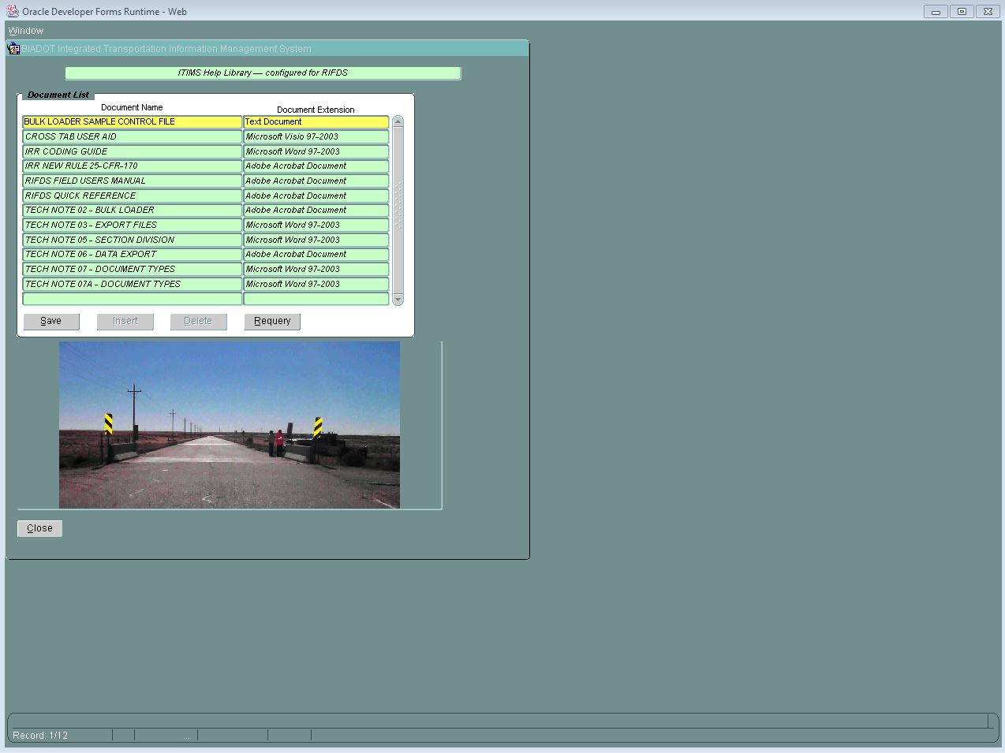
Basic Navigation – Help Library Screen

Slide 34
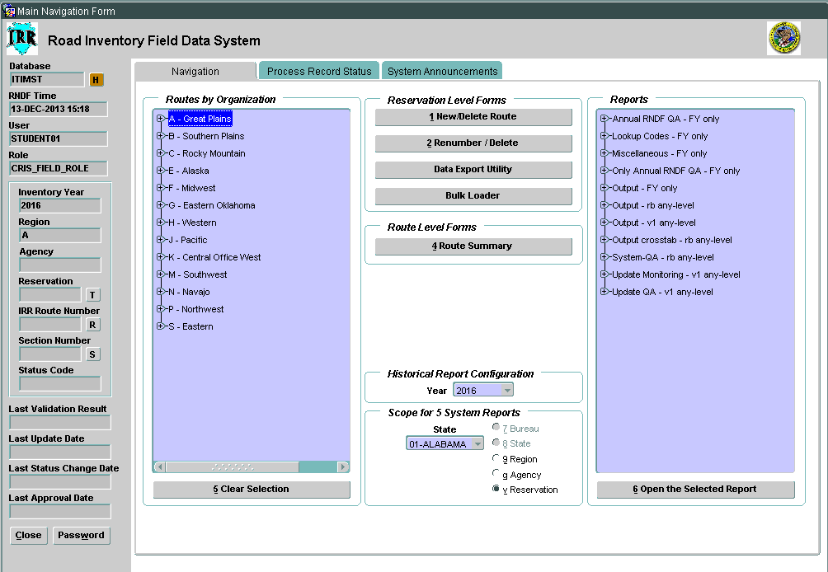
Basic Navigation – “Navigation” Tab

Slide 35
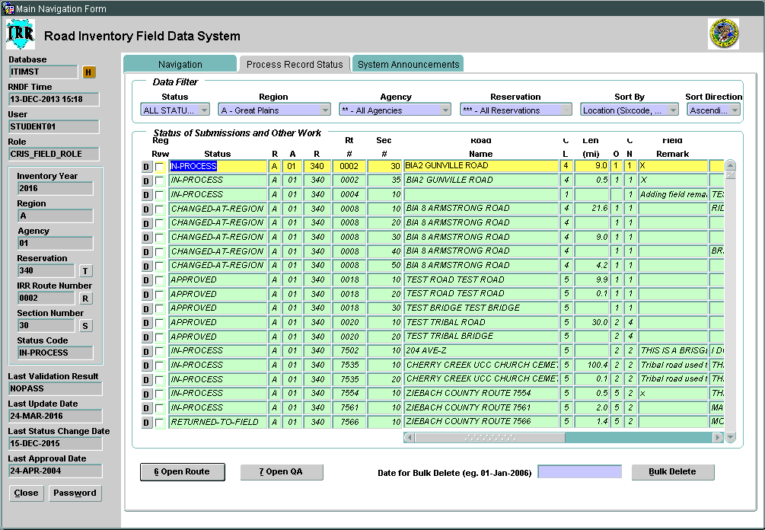
Basic Navigation – “Process Record Status” Tab

Slide 36
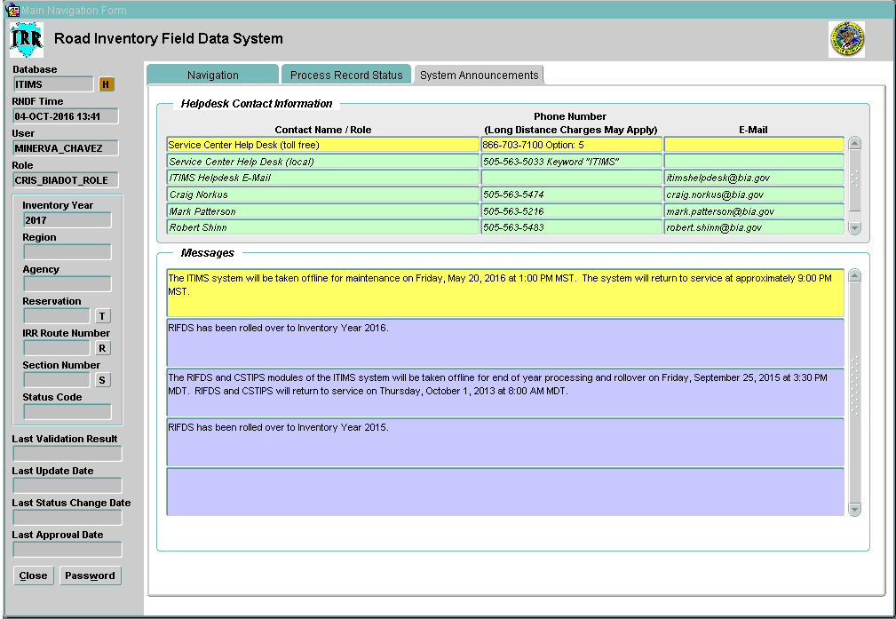
Basic Navigation – “System Announcements” Tab

Slide 37
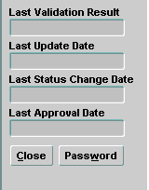
Logging Off
User will have to close forms first to return to the Main Navigation screen
From Main Navigation screen click on “CLOSE” located at the bottom of the Vertical Tool Bar

Slide 38
Changing/Modifying the Inventory
“Corrections” to existing record/route/facility
170.442 (e)
“the Secretaries have the authority to maintain the NTTFI and shall ensure the eligibility of the facilities and the accuracy of the data included in the NTTFI.”

Slide 39
Changing/Modifying the Inventory (cont.)
“Updating” a Legacy or RIFDS-ready record
170.444(b) – “updating the data on a facility currently listed in the NTTFI is carried out as follows:”
Renumber a route or section
Delete a route or section
“Direct-to-Official” tab updates

Slide 40
Changing/Modifying the Inventory (cont.)
“Adding” a new record/route/facility
170.444 (a) - “Submitting data into the NTTFI for a new facility is carried out on an annual basis as follows:”
170.446 (a-g) - minimum attachments apply
(h) - if record/route/facility is proposed, see 170.443
170.443 (a)(1-8) - additional attachments apply
- BIADOT/FHWA quality assurance team
(b) - ‘optional’ attachments

Slide 41
170.443 - BIADOT/FHWA review team
Reports to:
Erin Kinley, Director – Office of Tribal Transportation (FHWA)
LeRoy Gishi, Chief – Division of Transportation (BIADOT)
Team Co-Leads:
Anthony Spann - Office of Tribal Transportation
Paul Bonar - BIA, Western Regional Office

Slide 42
The Validation Routine in RIFDS
Running the Validation Routine
“SAVE” button at bottom of all section input screens
Pre-Validation Errors
Core Validation Errors
Attachment Validation Errors
Will happen upon hitting submittal button

Slide 43
What Happens When an Update Record is Submitted to BIADOT
Update Records are submitted to and reviewed by BIADOT QA staff .
They review the route and attachments and either approve or return them to the Region or Field.
If returned, the BIADOT staff place remarks in the “BIA-DOT Remark” field.

Slide 44
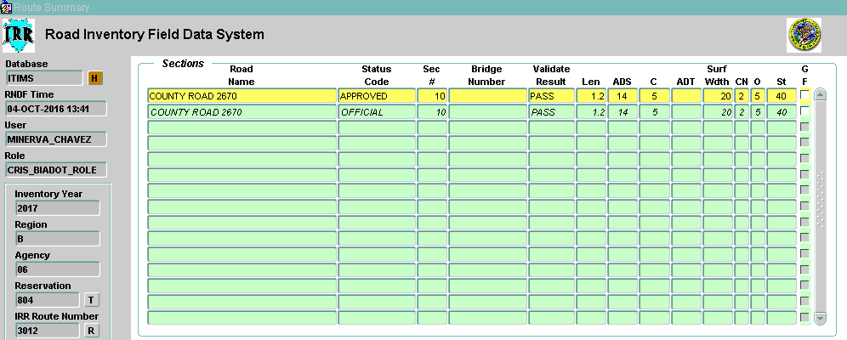
What Happens When an Update Record is Submitted to BIADOT (cont.)
When approved, a secondary “APPROVED” record is generated and must be discharged to complete approval process.

Slide 45
RIFDS Wrap-Up
You now know the basics of how to:
Access RIFDS at your role level
Navigate around RIFDS
Change & enter data relating to routes and sections
Handle attachments like a pro
Access & view reports

Slide 46
Where to go for HELP
ITIMS Helpdesk: (866)703-7100
Riley Green riley.green@bia.gov
Danielle Pablito danielle.pablito@bia.gov
RIFDS Help Library
Regional staff
BIADOT Staff:
Clarence Kie (505) 563-3315 mobile (505) 350-2242
Minerva Chavez (505) 563-3779 mobile (505) 506-9346
Christopher Becenti christopher.becenti@bia.gov
Aldon Francisco aldon.francisco@bia.gov

