Slide 1
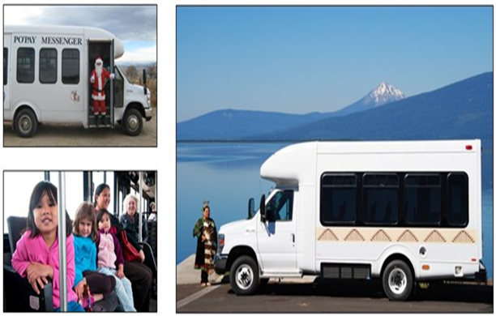
FTA Tribal Transit Program
ITA
June 2022
Marianne Stock and Elan Flippin
Place any image here If you do not want to use a
cover image,
delete this slide and use the next
slide instead
Office of Program Management
Federal Transit Administration

Slide 2
Agenda
TTP Overview
TTP Funding Levels
Competitive Program Update
Targeted Technical Assistance
Tribal Transit Technical Assistance Assessments
Resources
Questions/Open Dialogue

Slide 3
Tribal Transit Program Overview
The Tribal Transit Program provides direct funding to federally recognized American Indian and Alaskan Native Tribes for public transportation services on and around Indian reservations or tribal lands in rural areas.
Eligible activities under the program includes: planning, operating and capital projects
Tribal Transit Program has two components:
Formula funding is apportioned to tribes who report transit data to the National Transit Database (NTD). Census data is also used under the formula program.
Competitive funding is made available in a Notice of Funding Opportunity each year.

Slide 4
Tribal Transit Program Funding
The Bipartisan Infrastructure Law (FY 2022-2026)
Continued and increased the Tribal Transit Program by nearly 83%
Currently supports 134 American Indian and Alaskan Native Tribes with transit service

Slide 5
FY2022 Tribal Transit Competitive Program
FTA published a Notice of Funding Opportunity (NOFO) on February 16, 2022
Approximately $8.7 million is available in FY22
Application period closed on May 25, 2022
FTA received 47 applications, totaling $18M
Project selections are expected to be announced in the Fall

Slide 6
Low or No Emission and Buses and Bus Facilities Competitive Programs—Tribes are Eligible
In FY 2022, over $1.7 billion is available in combined funding ($1.1 billion for Low-No and $372 million for Bus)
Eligible applicants include designated recipients, states, local governmental authorities, and Tribes
FTA published a joint Notice of Funding Opportunity (NOFO) on March 4, 2022.
Applications were due on May 31, 2022.
Statutory deadline for the announcement of project selections is August 15, 2022

Slide 7
Targeted FTA Technical Assistance for Tribes
FTA’s Tribal Entities Landing Page contains concise information for Tribes who are interested in becoming FTA recipients
Regional Tribal Liaisons in each FTA regional office provide targeted technical assistance to Tribal grantees
Conducted Buses and Bus Facilities and Low or No Emissions competitive program webinars targeted specifically to rural and Tribal applicants in 2022
Published and distributed resources explaining how Buses and Bus Facilities and Low or No Emissions competitive programs differ from the Tribal Transit competitive program
For unselected applicants, FTA offers debriefs which includes ways for applicants to improve their competitive grant program proposals

Slide 8
National Rural Transit Assistance Program (NRTAP)
FTA 5311-funded technical assistance center which provides targeted technical assistance to rural transit providers, including Tribes
Collaborates with FTA and Tribes to provide resources to ensure Tribal Transit programs are successfully implemented
Offers training and technical assistance on grant writing for competitive funding opportunities eligible to Tribes
Conducts Tribal Transit trainings and workshops throughout the country specifically tailored to address the technical assistance needs of the Tribes in that region
Attends Tribal Transit conferences and provides training assistance on topics such as transit facility planning and capital project development
Develops training modules for tribal transit agencies

Slide 9
Technical Assistance Assessments
As part of the Tribal Transit Program, FTA offers targeted technical assistance through the Tribal Transit Technical Assistance Assessments Initiative
FTA collaborates with Tribal Transit recipients to review processes and identify areas in need of improvement and then assists to offer solutions to address these needs
These assessments include:
Discussions of compliance areas pursuant to the Master Agreement and TTP program requirements,
Site visit,
Promising practices reviews, and
Ongoing technical assistance from FTA and its contractors.

Slide 10
Links and Resources
Tribal Transit Formula Grants - 5311(c)(1)(B) | FTA (dot.gov)
Public Transportation on Indian Reservations Program; Tribal Transit Program | FTA (dot.gov)
Grants for Buses and Bus Facilities Program | FTA (dot.gov)
Low or No Emission Vehicle Program - 5339(c) | FTA (dot.gov)
Formula Grants for Rural Areas - 5311 | FTA (dot.gov)
https://www.nationalrtap.org/
Tribal Entities Landing Page

Slide 11
Questions
Contact:
Elan Flippin, Tribal Transit Program Manager
Elan.Flippin@dot.gov
TribalTransit@dot.gov

Slide 12
