Slide 1


FHWA Office of Tribal Transportation Program Review Process FY 21
Greg Newhouse
2021 Intertribal Transportation Association
(ITA) Virtual Mid-Year Meeting
PMA - OTT
June 9, 2021

Slide 2
Greg Newhouse
FHWA Office of Tribal Transportation
Program Management Analyst
FHWA OTT 2+ Yrs.
FHWA Wisconsin Division Office
Program & Project Delivery Engineer 3 Yrs.
Bureau of Indian Affairs
Midwest Regional Office
Highway Engineer 15 Yrs.
Alliant Techsystems Inc.
Test and Evaluation Engineer 12 Yrs.

Slide 3
Why Do Program Reviews?
Stewardship and Oversight Requirements
§170.703 What program reviews do the Secretaries conduct?
In accordance with title 23, the national business plan, 2 CFR part 200, and the Program Agreement or other appropriate agreements, BIADOT and FHWA shall conduct formal program reviews of BIA Regional Offices or Tribes to examine program procedures and identify improvements.
The review will provide recommendations to improve the program, processes and controls of management, planning, design, construction, financial and administration activities.

Slide 4
OTT Relationship With Tribes
Critical Element
Through mutual respect and understanding, enhance the quality of life in Tribal communities by supporting the Tribes’ delivery of transportation programs.
Derive a process to fulfill S&O requirements and to assist the tribes in the delivery of the TTP program by identifying program areas that may require technical assistance or training.
Identifiers
Conformance to Regulations
Technical Assistance
Training / Education

Slide 5
Tribal Transportation Program Information Reviews (TTPIR)
  Currently ONLY Applicable to FHWA Program Agreement Tribes.
  Presented to BIA Regions – Hoping to Collaborate with BIA to Establish a Single Process for Program Reviews.
  Key Features
  Risk Base Selection Process
  Goal to have ALL TRIBES Reviewed During an Authorization Period
  TTPIR Conducted Remotely
  Reduced Program Element Approach
  Less Intrusive or Intimidating to Reviewees
  Modified Question Guides
  SOP Development

Slide 6
Tribal Transportation Program Information Reviews (TTPIR)
  Traditional Program Reviews Are NOT Working !!
  FHWA Currently Re-Tooling Entire Program Review Process. Starting from Scratch.
  Too Rigid in Format – Reduced Flexibility
  Use of Charters – Waste of Time
  Templates for Reporting
  Too Many Questions !!
  Data Requests - Too Much !!
  Reviewees & Reviewers Overloaded !!
  Several Weeks/Months Typical
  No Value Added
  Not Efficient
  Not Effective
  Not Helpful

Slide 7
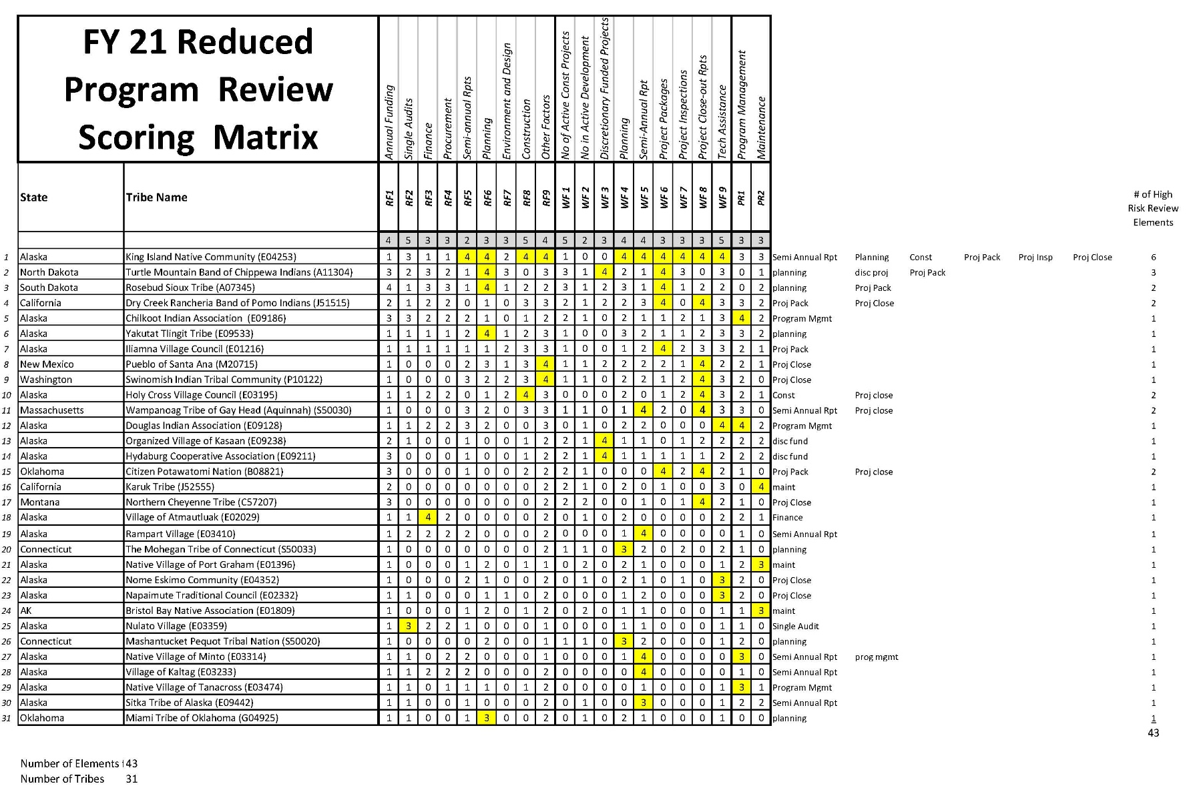
TTPIR
  Risk Assessment Developed 19 Elements Evaluated
  (Example)

Slide 8
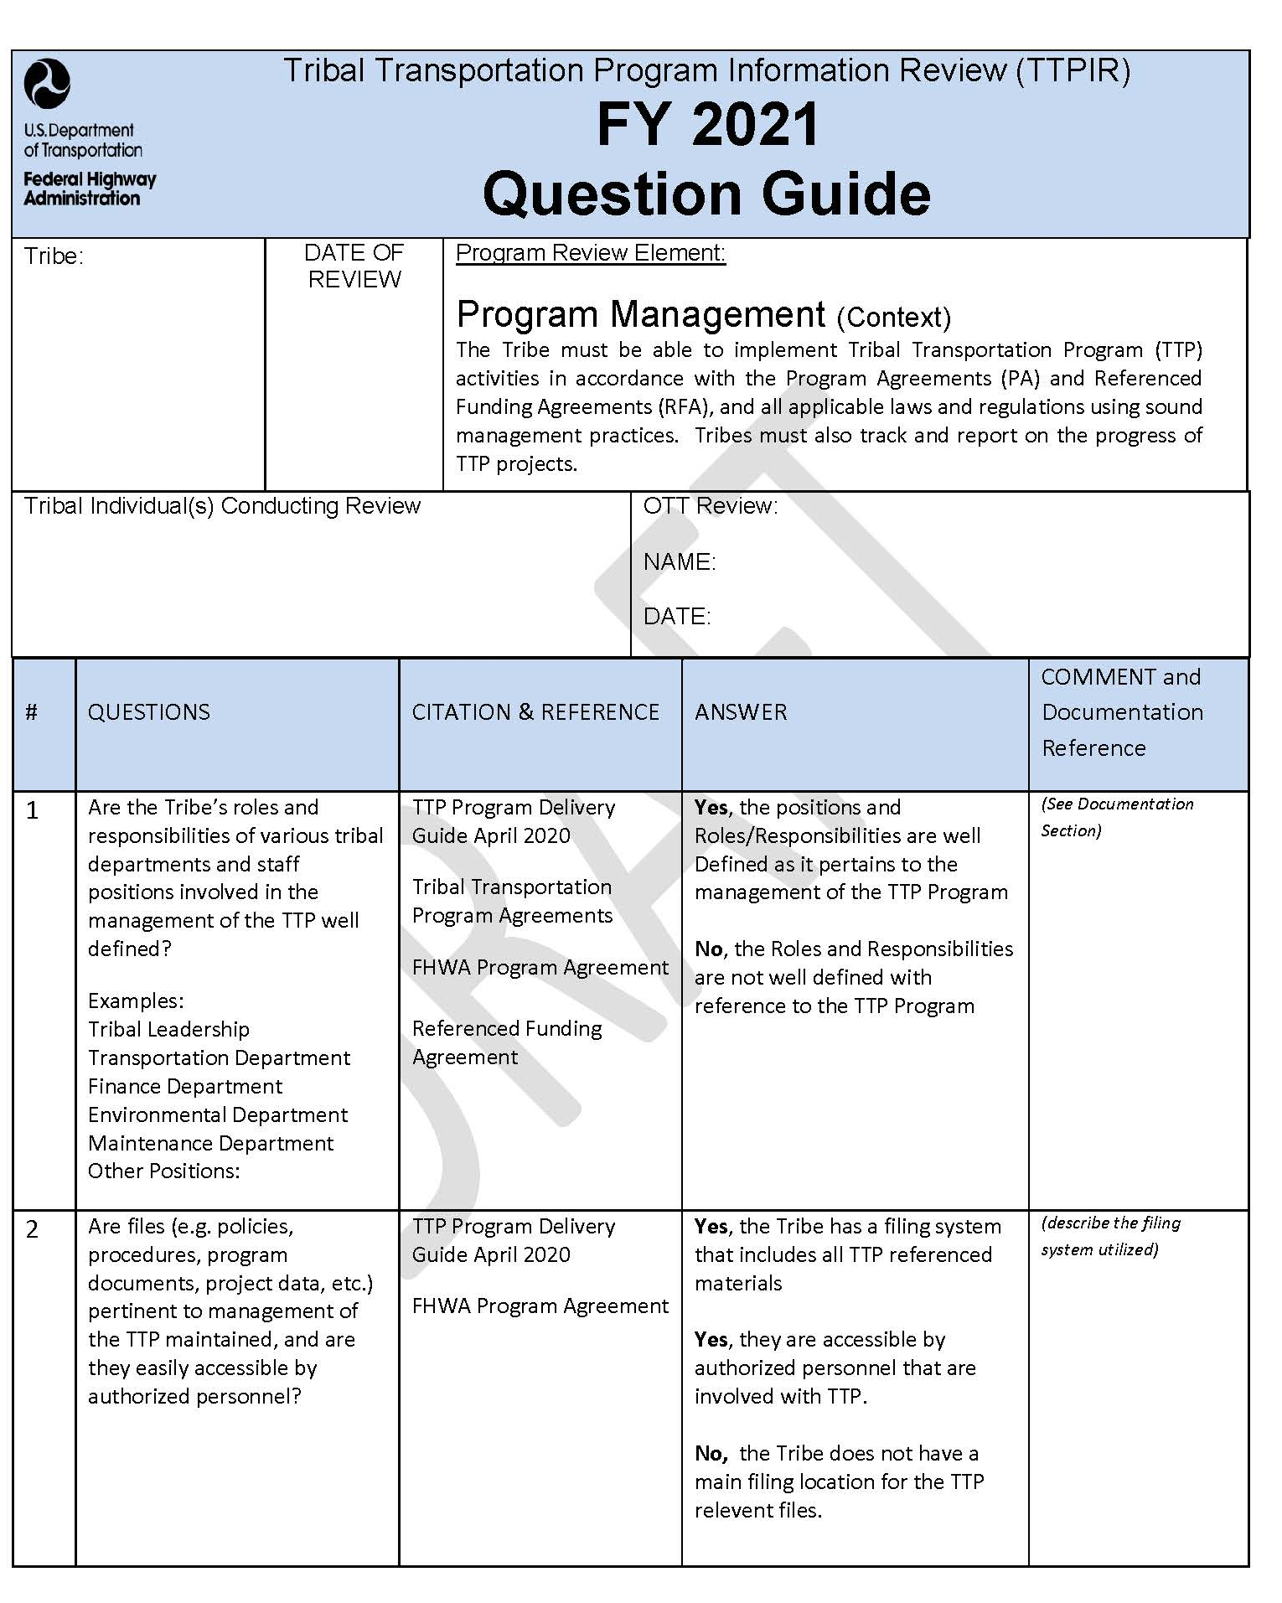
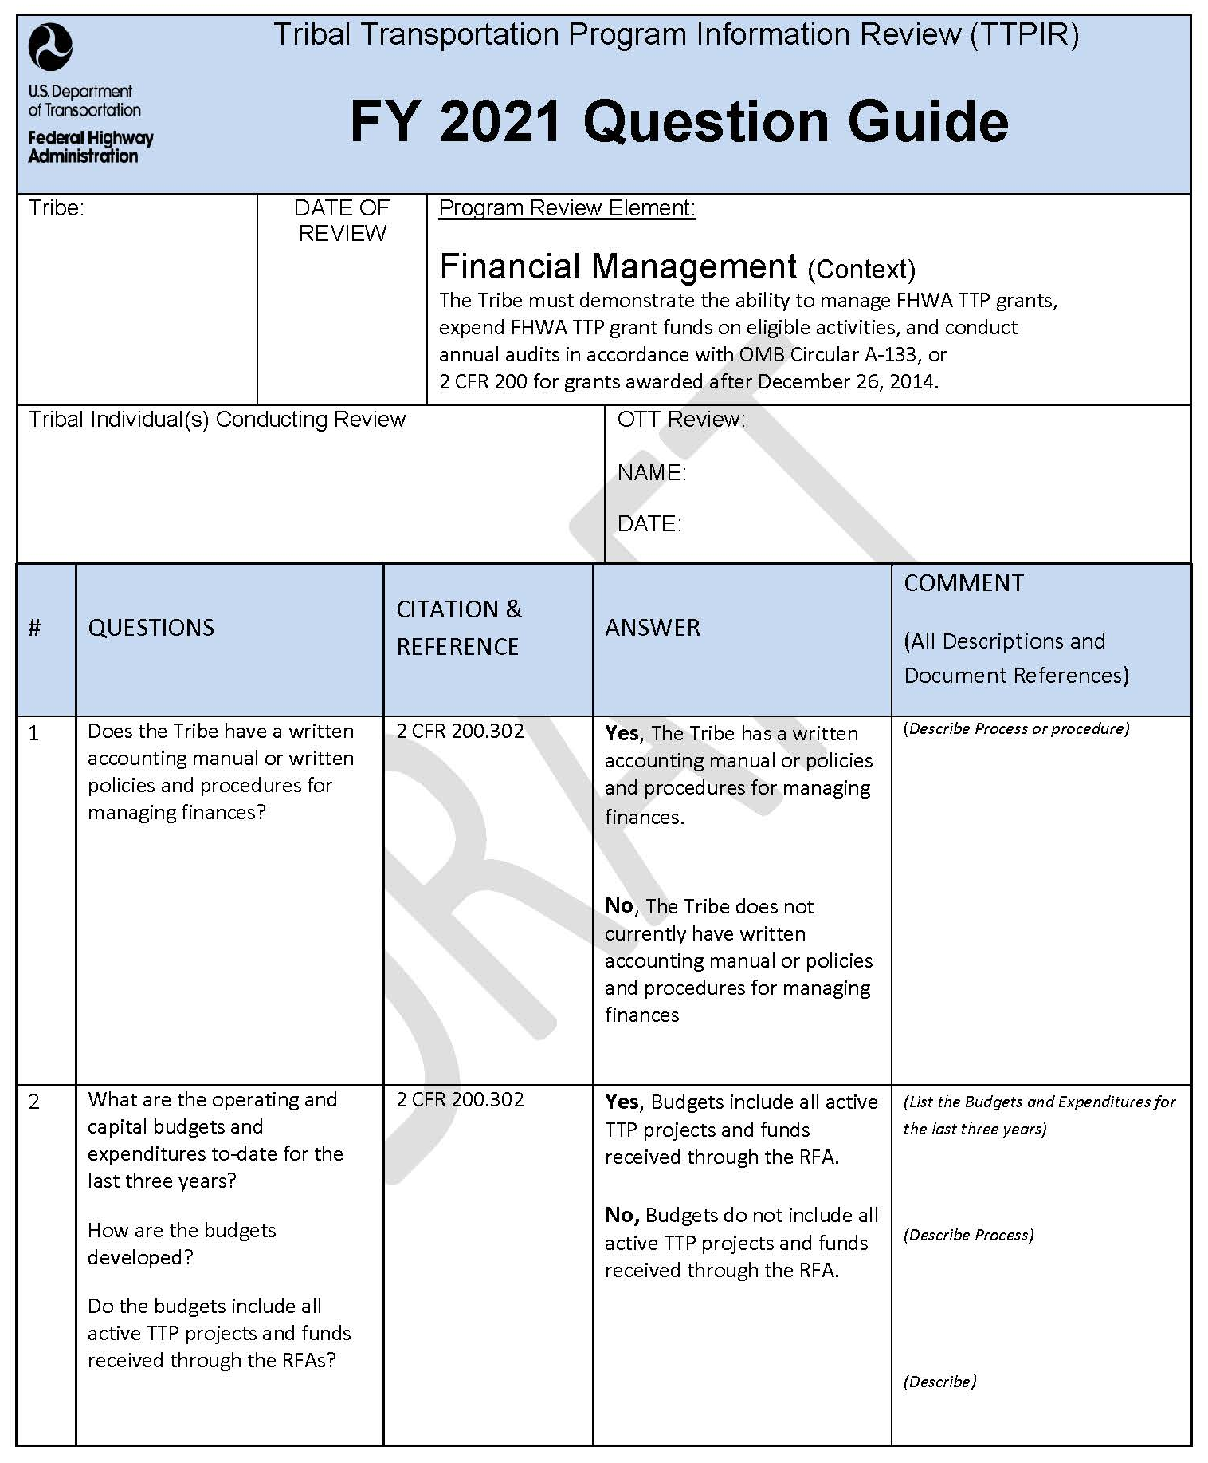
TTPIR
  Modified Question Guides – Reduced Data Request

Slide 9
TTPIR
  Question Guides Fully Developed - Reflects Current Main TTP Elements
  Program Management
  Financial Management
  Procurement
  Planning
  Project Development and Packaging
  Construction and Construction Monitoring
  Maintenance
  Question Guides in Development Others In Consideration
  Project Close-out Process Project Authorization Process
  Semi- Annual Reporting NEPA
  Discretionary Funds / Projects Work Zone
  Project Inspection ERFO
  Bridge Project Agreements
  Safety Change Order
  QC/QA

Slide 10
TTPIR Data Request
  Data is Requested along with Answers to Question Guides – Supporting Documentation. Directly supports the answer.
    A NO or Negative Response is perfectly Acceptable!!!
    Not a ‘Gotchya’ Process – Assists OTT in Identifying Areas Where Technical Assistance may be Required.
    If an Area is Currently In Development with the Tribe – Indicate that where appropriate and expand on accomplishments to date!
  Will Vary Depending on the Question Guide
  Prefer using the Recently Developed TTP Share-Point Site to Send Data to OTT.
  Can use a Thumb Drive to send Data as Well.
  Detailed Information will be provided on the Cover Letter along with a Guide Tool and Instruction Packet.

Slide 11
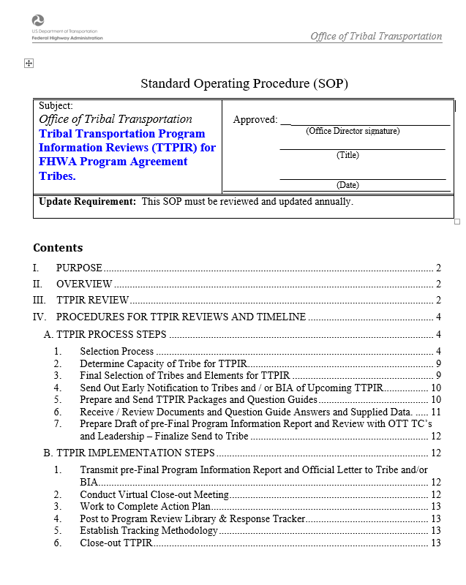
  SOP Development for Conducting TTPIR

Slide 12
TTPIR SoP

Slide 13
TTPIR SoP

Slide 14
    TTPIR Action Plan Development Scenarios
Action Plan Not Needed
  Final Report indicates an action plan is not needed
  OTT will work with Tribe to resolve any minor observations not rising to the level of an action plan.
Action Plan and Review Tracker Completed.
  Likely low-level of complexity on observations and recommendations
  Tribes likely agree upon next steps moving forward.
  OTT confirms all parties are fine with the Action Plan as-is and will be included in the Final Program Information Report.
  Action plan mimics input into the Response Tracker with agreed upon resolution.
Action Plan Developed
  Potential for higher levels of complexity on observations and recommendations
  Requires additional Technical Assistance to Tribe
  OTT and Tribe have worked to complete the draft Action Plan
  Action plan may or may not be included in the Final Program Information Report and may be deferred.

Slide 15
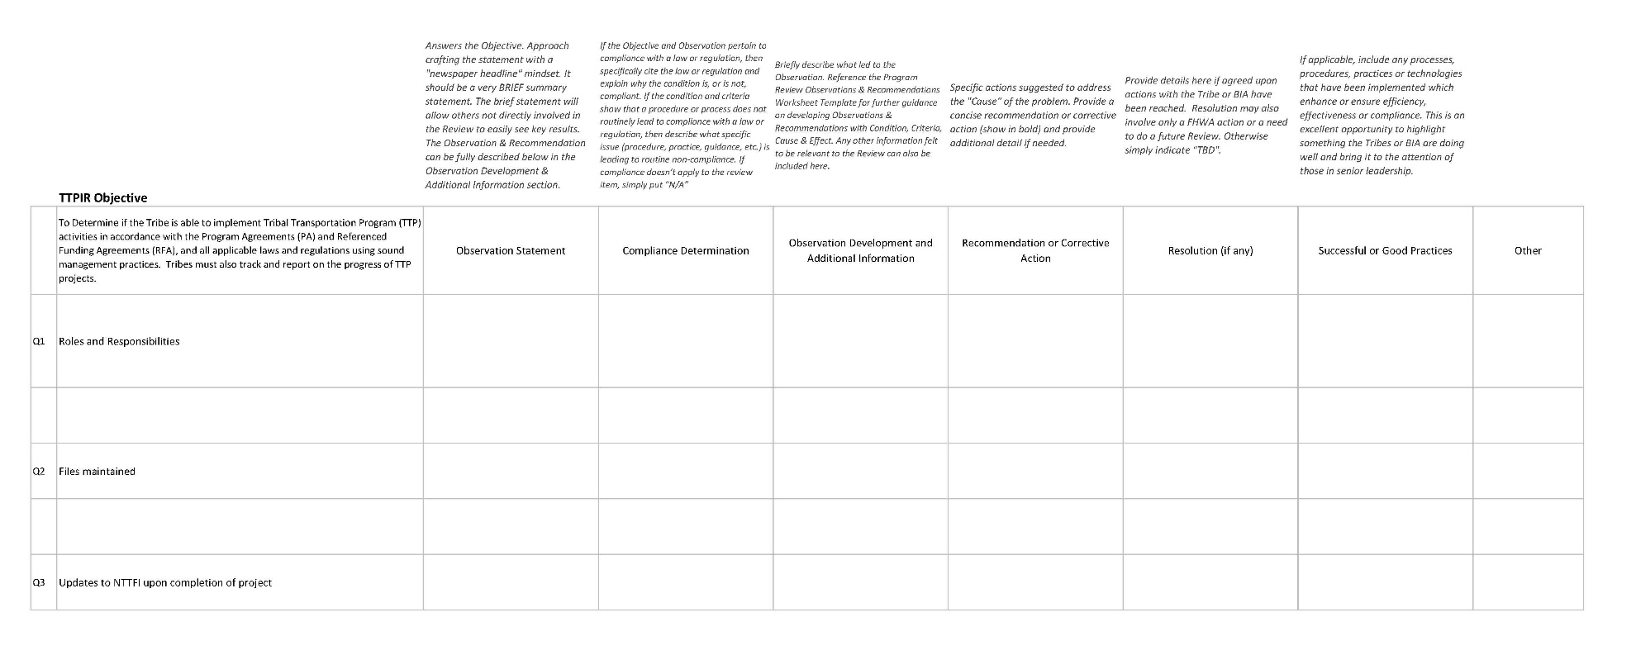
TTPIR Tracking
  Program Review Summary Worksheet.
  Provides Base Data to Feed Reports and Review Response Tracker

Slide 16
TTPIR Timeline Typical
Annual Risk & Workload Assessment January
Selection Criteria from Risk Assessment January / February
Final Selection of TTPIR Tribes & Elements February
Early Notification – (15 Days Out) March 1st
Send TTPIR Packages to Tribes (Allow 45 Days) March 15th
Receive Completed TTPIR May 1st
Review / Confirmation Letter May 30th
Draft pre-Final Program Information Report(s) June
Work to Develop Action Plan(s) if Necessary July-August
Input into Program Review Library and Tracker August
Continue to Monitor Progress Rest of CY
Close-out TTPIR If Possible Rest of CY

Slide 17
TTPIR Now – Iteration 1
Annual Risk & Workload Assessment Complete
Selection Criteria from Risk Assessment Complete
Final Selection of TTPIR Tribes & Elements Complete
Early Notification – (15 Days Out) Complete
Send TTPIR Packages to Tribes (Allow 45 Days) Complete
Receive Completed TTPIR In Progress
Review / Confirmation Letter June 30th
Draft pre-Final Program Information Report(s) July
Work to Develop Action Plan(s) if Necessary August - September
Input into Program Review Library and Tracker September
Continue to Monitor Progress Rest of CY
Close-out TTPIR If Possible Rest of CY

Slide 18
TTPIR Now – Iteration 1
TTPIR Packages sent to Tribes on April 15^{th.}
Allow Tribes 45 Days to Complete.
Extensions have been Requested and Approved
17 Tribes Selected.
2 Program Areas per Tribe.
34 Total Reviews Being Conducted.

Slide 19
TTPIR Now – Iteration 1
TTPIR Package
  Cover Letter or Email Describing Process and Next Steps
  Question Guides for Program Areas Being Reviewed
  Sample of Question Guide
  TTPIR Information Tool Guidance

Slide 20
TTPIR Now – Iteration 1

Slide 21
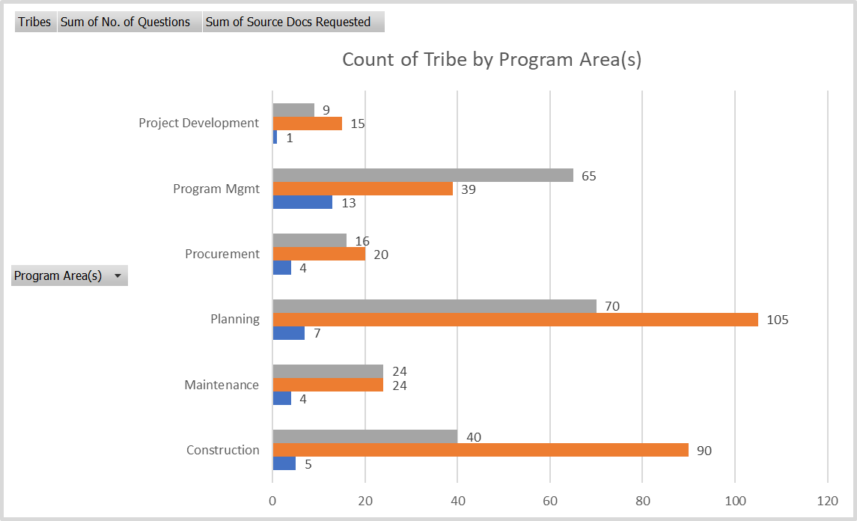
TTPIR Now – Iteration 1

Slide 22
TTPIR Next Steps
  FHWA OTT Participating in National Pilot for Next Generation of Program Reviews.
  FY21 Iteration # 2 is being Developed for an Additional 18 Tribes.
  Work with BIA to Assist in Process

Slide 23
Questions?
Gregory J. Newhouse
Program/Management Analyst
FHWA – Office of Tribal Transportation TTP
West 525 Junction Road, Suite 8000
Madison, WI 53717
Office: 608-829-7521
Cell: 715-292-3250
Gregory.Newhouse@dot.gov

