Slide 1

BIA Transportation
Section 14006
Road Maintenance Study
Nov. 1, 2022

Slide 2
Overview
Bipartisan Infrastructure Law –
Sec. 14006: Study of Road Maintenance on Indian Land

Slide 3
BIA Road Maintenance
BIA/FHWA are engaging in BIA RM Program Pre-meetings
- Meeting purpose
P.L. 117-58; IIJA Section 14006 Overview
Evaluation Criteria
Construction and Maintenance
BIA Road Maintenance Program
(Background)
Funding
Questions

Slide 4
Meeting Purpose

Slide 5
Purpose
The BIA and the Federal Highway Administration’s Office of Tribal Transportation will provide a road maintenance program overview on the implementation and operation of the BIA Road Maintenance Program (RMP). Most tribal transportation program directors and operators are familiar with the Tribal Transportation Program authorized in 23 USC §202; but are not familiar with the BIA RMP and how the two programs relate. Each year approximately $30-35 million is provided nationally to specific tribes and BIA field offices to maintain BIA roads.
These meetings will provide clarification on the program function and purpose.

Slide 6
Purpose
In 2021, Congress passed P.L. 117-58, Infrastructure Investment and Jobs Act of 2021 (IIJA) or otherwise known as the Bipartisan Infrastructure Law (BIL). Section 14006 of IIJA requires the Secretary of the Interior in consultation with the Secretary of Transportation to consult with Indian tribes that have jurisdiction over roads eligible for funding under the road maintenance program of the Bureau of Indian Affairs.
In preparation of the consultation (to be announced), the BIA and FHWA will provide this overview meeting to assist tribes in understanding the differences in the maintenance program and the construction program.
At a recent Tribal Transportation Program Coordinating Committee, the tribes requested an overview to assist them in understanding the maintenance program operations so they are informed and can more readily provide input, comments, and recommendations during the consultation sessions.

Slide 8
P.L. 117-58; IIJA Sec. 14006

Slide 9
Section 14006 (a)
(a) Definitions.--In this section:
(1) Indian land.--The term ``Indian land'' has the meaning given the term ``Indian lands'' in section 3 of the Native American Business Development, Trade Promotion, and Tourism Act of 2000 (25 U.S.C. 4302).
(2) Indian tribe.--The term ``Indian tribe'' has the meaning given the term in section 4 of the Indian Self-Determination and Education Assistance Act (25 U.S.C. 5304).
(3) Road.--The term ``road'' means a road managed in whole or in part by the Bureau of Indian Affairs.
(4) Secretary.--The term ``Secretary'' means the Secretary, acting through the Assistant Secretary for Indian Affairs.

Slide 10
Evaluation Criteria

Slide 11
Section 14006 (b)
(b) <> Study.--Not later than 2 years after the date of enactment of this Act, the Secretary, in consultation with the Secretary of Transportation, shall carry out a
study to evaluate--
(1) the long-term viability and useful life of existing roads on Indian land;
(2) any steps necessary to achieve the goal of addressing the deferred maintenance backlog of existing roads on Indian land;
(3) programmatic reforms and performance enhancements necessary to achieve the goal of restructuring and streamlining road maintenance programs on existing or future roads located on Indian land; and
(4) <> recommendations on how to implement efforts to coordinate with States, counties, municipalities, and other units of local government to maintain roads on Indian land.

Slide 12
Section 14006 (c) and (d)
(c) Tribal Consultation and Input.--Before beginning the study under subsection (b), the Secretary shall--
(1) consult with any Indian tribes that have jurisdiction over roads eligible for funding under the road maintenance program of the Bureau of Indian Affairs; and
(2) solicit and consider the input, comments, and recommendations of the Indian tribes described in paragraph (1).
(d) <> Report.--On completion of the study under subsection (b), the Secretary, in consultation with the Secretary of Transportation, shall submit to the Committees on Indian Affairs and Environment and Public Works of the Senate and the Committees on Natural Resources and Transportation and Infrastructure of the House of Representatives a report on the results and findings of the study.

Slide 13
Section 14006 (e)
(e) <> Status Report.--Not later than 2 years after the date of enactment of this Act, and not less frequently than every 2 years thereafter, the Secretary, in consultation with the Secretary of Transportation, shall submit to the Committees on Indian Affairs and Environment and Public Works of the Senate and the Committees on Natural Resources and Transportation and Infrastructure of the House of Representatives a report that includes a description of--
(1) the progress made toward addressing the deferred maintenance needs of the roads on Indian land, including a list of projects funded during the fiscal period covered by the report;
(2) the outstanding needs of the roads that have been provided funding to address the deferred maintenance needs;
(3) the remaining needs of any of the projects referred to in paragraph (1);
(4) how the goals described in subsection (b) have been met, including--
(A) <> an identification and assessment of any deficiencies or shortfalls in meeting the goals; and
(B) <> a plan to address the deficiencies or shortfalls in meeting the goals; and
(5) <> any other issues or recommendations provided by an Indian tribe under the consultation and input process under subsection (c) that the Secretary determines to be appropriate.

Slide 14
BIA Road Maintenance Program

Slide 15
Background (Quick Facts)
Only 290 of the 574 Tribes have BIA roads within their lands
Only 200 of the 574 Tribes perform BIA road maintenance via a 638 contract or agreement
The funds received from OIP TPA Road Maintenance can only be expended on maintaining BIA roads (29,700 miles of the 154,000 total miles managed by BIA/FHWA)
The BIA Maintenance program is not eligible for improvement. Improvement, construction, reconstruction are construction functions eligible under the Tribal Transportation Program.
85% of the BIA Roads are located in 6 Regions
59 Tribes have 80% of the BIA roads on their lands

Slide 16
Background
What is the current road maintenance program (RMP) of the BIA?
How is it funded?
How are funds allocated to the field?
Who is eligible to receive BIA RMP funds?
What transportation facilities are eligible under the BIA RMP?
How are RMP functions performed (projects or recurring routine functions)

Slide 17
Background (cont.)
What are current maintenance and other responsibilities for all roads on the NTTFI?
  Ownership
  Maint. Responsibilities
  Reconstruction responsibilities
Performance reporting
Deferred Maintenance Reporting
Funding under TPA
Other

Slide 18
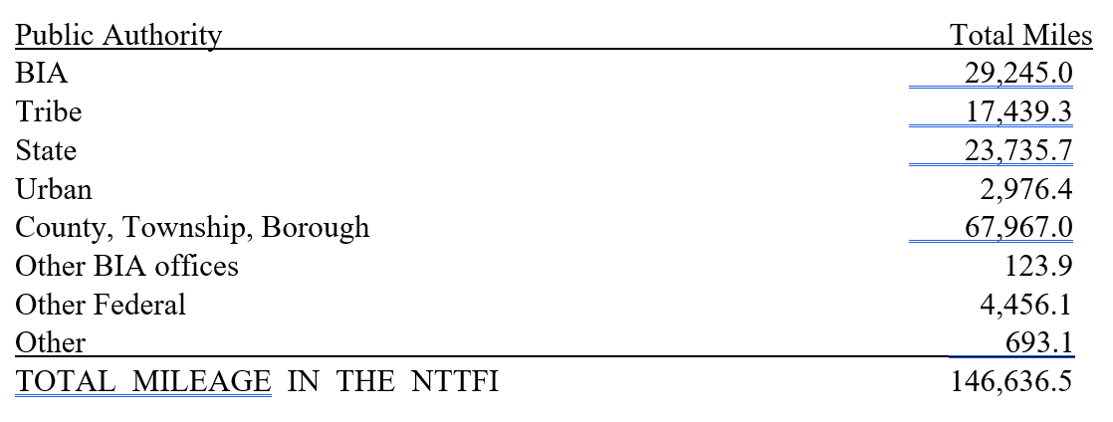
National Tribal Transportation Facility Inventory (NTTFI, 23 USC 202(b)(1))
These miles note “Existing” road miles. Not “proposed” as defined in 25 CFR 170.443.

Slide 19
National Tribal Transportation Facility Inventory (NTTFI, 23 USC 202(b)(1))
BIA Road Maintenance Program Eligible

Slide 20
Road Maint. Study Background
Definition: ROAD.—The term ‘‘road’’ means a road managed in whole or in part by the Bureau of Indian Affairs.
Work description. What work types are supported or allowed?
  Activities
Construction requires a change or improvement
  Reconstruction, resurfacing, repair(?), rehabilitation, improve
RM & Environmental (NEPA)?
RM & historic/cultural preservation?

Slide 21
Tribal Consultation
Consult with Indian tribes that have jurisdiction over roads eligible for funding under the road maintenance program of the BIA
Solicit and consider input, comments, and recommendations of the Indian tribes described above.

Slide 22
Construction and Maintenance

Slide 23
What is the difference?
Construction vs. Road Maintenance
Road and bridge maintenance by definition is the preservation of the structure/roadway in the as-built condition. It is not a reconstruction or improvement activity.
Construction is a rebuilding and/or improvement activity. Construction activities for Tribal Transportation facilities administered by the BIA and the Federal Highway Administration is funded with funds provided from the federal allocated dollars from USDOT (23 USC 202).

Slide 24
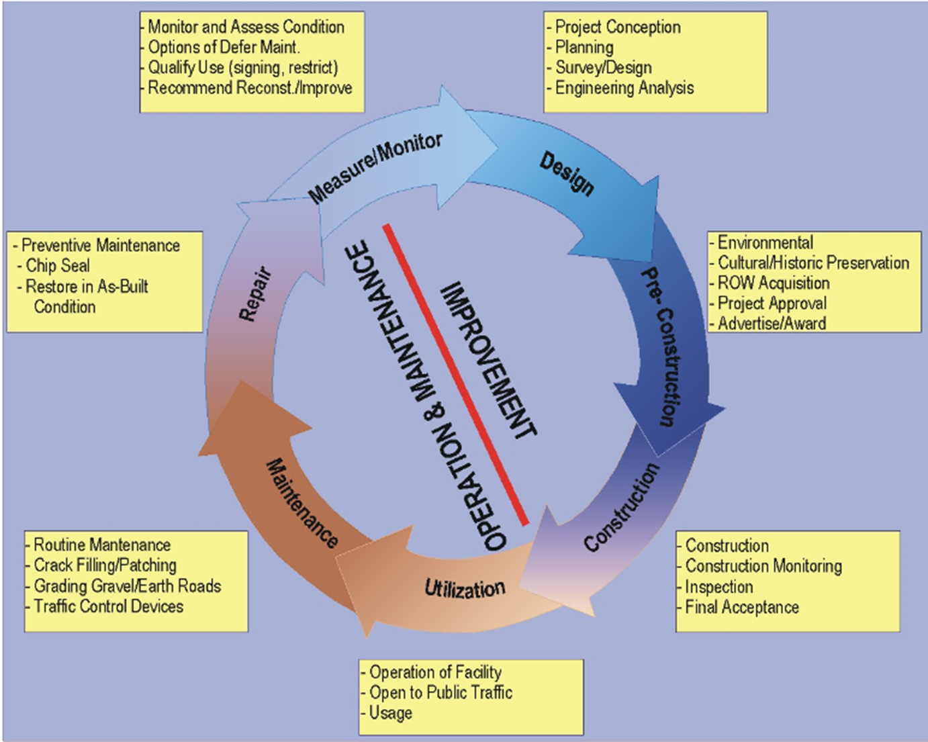

Slide 25
25 CFR 900.113 Definition of Construction
Sec. 900.113 Definitions.
(a) Construction contract means a fixed-price or cost-reimbursement self-determination contract for a construction project, except that such term does not include any contract:
  (2) For the Housing Improvement Program or roads maintenance program of the Bureau of Indian Affairs administered by the Secretary of the Interior;

Slide 26
Funding
Road Maint. Const.
Budget Authority
23 USC 318a
BIA “Green Book”
P.L. 93-638, Sec. 108
Tribal Priority Allocations
Annual Approps, $36.3 M (FY2022)
Historic percentages of the Regions (Region allocation methodologies)
Contract Authority
Title 23 USC 202(a)(8)
25 CFR 170 Subpart G
P.L. 93-638 Part 900 Subpart J and Part 1000 Subpart K
5-year authorization (generally) $578 M-$637 M
23 USC 202(b)(3), Tribal shares

Slide 27
TPA
Tribal priority allocations are a critical funding area for tribal governments because they cover such needs as economic development, welfare assistance, and natural resource management.

Slide 28
RM Fund Distribution Process
Program: Road Maintenance (TPA)
Type of Funding: Recurring (Non-Base) - Formula Funding
Funding Authority/Responsibility:
25 USC 318a; 23 USC 202; 25 U.S.C. 450 (The Indian Self-Determination and Education Assistance Act), 88 Stat. 2203, Public Law 93-638, Public Law 100-472; 102 Stat. 2285, Public Law 103-413.
The Deputy Bureau Director, Indian Services, is the SubAllottee and is responsibility for distribution of the funding.

Slide 29
RM Fund Distribution Process
Distribution Process:
OIS applies a formula based on Regional percentages. These percentages do not change by fiscal years and are based on historical percentages determined by miles of roads maintained at Tribal locations/lands.
Regional distribution is based on each Region’s own negotiated distribution criteria.
$200,000 is retained at the OIS level from the enacted level for emergency maintenance. This practice was established at the request of TIBC.
Regional Processing:
Indian Self Determination (ISD) Awarding Official negotiates terms, conditions of award, including payments. They prepare contract award/modifications in PRISM.
OSG Processing:
OSG will process the funding document, and obligate funding.

Slide 30
Questions

