Slide 1
Tribal Transportation Program (TTP) and Bipartisan Infrastructure Law (BIL)* Overview
Erin Kenley, Director
FHWA - Office of Tribal Transportation
June 29, 2022
*Also known as the “Infrastructure Investment and Jobs Act”

Slide 2
Tribal Transportation Program - BIL
Funding
FY22 - $578,460,000 (Contract Authority)
FY23 - $589,960,000 (Contract Authority)
FY24 - $602,460,000 (Contract Authority)
FY25 - $612,960,000 (Contract Authority)
FY26 - $627,960,000 (Contract Authority)
Total: $3,011,800,000

Slide 3
Tribal Transportation Program - BIL
Safety
4% Set-aside from TTP (Was 2%)
FY22 NOFO Open
Estimated Funding amount $23.1 million
Application due date: September 15, 2022
6.4.22 Clean per OST C edits (dot.gov)

Slide 4
Tribal Transportation Program Safety Fund
FY21 - 2% set-aside from TTP
Approximately $9 M available
Awards announced last week
75 applications requesting $26 M
58 awards to 51 Tribes in 17 states
FY21 Tribal Transportation Program Safety Fund Awards.xlsx (dot.gov)

Slide 5
FHWA Awards Nearly $9 Million for Tribal Transportation Safety Improvements and Announces Additional $120 Million Available Thanks to President’s Bipartisan Infrastructure Law | FHWA (dot.gov)
Issued June 7th
References FY21 TTPSF Awards
Announces the FY22 TTPSF NOFO
Rolls out the TTPBF Guidance (Q&A’s)
Rolls out the “Transportation Funding Opportunities for Tribal Nations” Brochure

Slide 6
Tribal Transportation Program - BIL
High Priority Projects (HPP)
$9 M/year set-aside from TTP (New)
$30 M/year subject to appropriations from the General Fund
Not included in the FY22 Consolidated Appropriations Act
To be administered as described in MAP-21 (2012)
Will use the project scoring matrix from original 25 CFR 170
Still a lot of details to be worked out
Legal Counsel started looking at it last week

Slide 7
Safe Streets and Roads for All (SS4A) - BIL
The Safe Streets for All Notice of Funding Opportunity (NOFO) announced Monday can be found at https://www.transportation.gov/SS4A.
Applications are due on or before Sept. 15, 2022.
Stakeholder webinars
Monday, June 13: How to Apply for the Safe Streets and Roads for All (SS4A) Opportunity
Wednesday, June 15: How to Apply for the Safe Streets and Roads for All (SS4A) Opportunity: Focus on Action Plan Grants
Thursday, June 23: How to Apply for the Safe Streets and Roads for All (SS4A) Opportunity: Focus on Implementation Grants
Additional information and resources about the SS4A Grant Program, including webinar links, also can be found at https://www.transportation.gov/SS4A.

Slide 8
Nationally Significant Federal Lands and Tribal Projects Program (NSFLTP) - BIL
Funding - $275 M (FY 22-26) in contract authority from the HTF
Reduces (from $25 M to $12.5 M) minimum eligible project cost
Modifies the Federal share requirements:
Federal share for tribal projects is 100%;
For other projects, it allows Title 23 and Title 49 funds to be used for the “non‐Federal” share
Requires an even split between tribal and Federal lands projects
Of the funds for Federal lands projects, requires that at least 1 eligible project be carried out in a unit of the National Park System with ≥3 M annual visitors

Slide 9
National Significant Federal Lands and Tribal Project Program
FY21 - $100 M available
12 applications requesting $932 million
Award announced soon
FY22 – $125 M available
Includes $75 M from the GF (FY22 Appropriations Act)
NOFO released soon

Slide 10
Tribal Transportation Program - BIL
Section 14002 – Environmental Review for Certain Tribal Transportation Facilities
Sets time limits on Federal NEPA Decisions and Permitting actions for Tribal Transportation Safety Projects
Safety Projects: Projects that include features listed in 23 USC 148(a)(4)(B)
45 days to issue a NEPA Decision
Another 45 days to issue permits
Allows an extension with written notice and explanation to the Tribe
30 days

Slide 11
Tribal Transportation Program - BIL
Section 14003 – Programmatic Agreements for Tribal Categorical Exclusions
Agreements to delegate Federal authority for approval of categorical exclusions under the National Environmental Policy Act.
Similar authority previously delegated to Tribes by HUD.
Similar authority previously delegated to State DOTs by FHWA.
A proposed, draft template agreement is being developed.
Shall have a term of not more than 5 years

Slide 12
Transportation Funding Opportunities for Tribal Nations (dot.gov)
Federal Role
How to Access Fundings
Dedicated Tribal Programs and Other Programs
Outlines:
Purpose
Funding
Program Type
Federal Share
Eligible activities
BIL Changes to TTP
Additional Information and Assistance

Slide 13
Tribal Technical Assistance Program (TTAP)
NOFO Issued January 24, 2022
Application Deadline March 24, 2022
Application Deadline Extended to May 2, 2022
$17.875 M Award Ceiling Across 4 Years
7 TTAP Centers Anticipated – 1 for Rocky Mt. & Great Plains
Formal Partnership Between TTAP and OTT

Slide 14
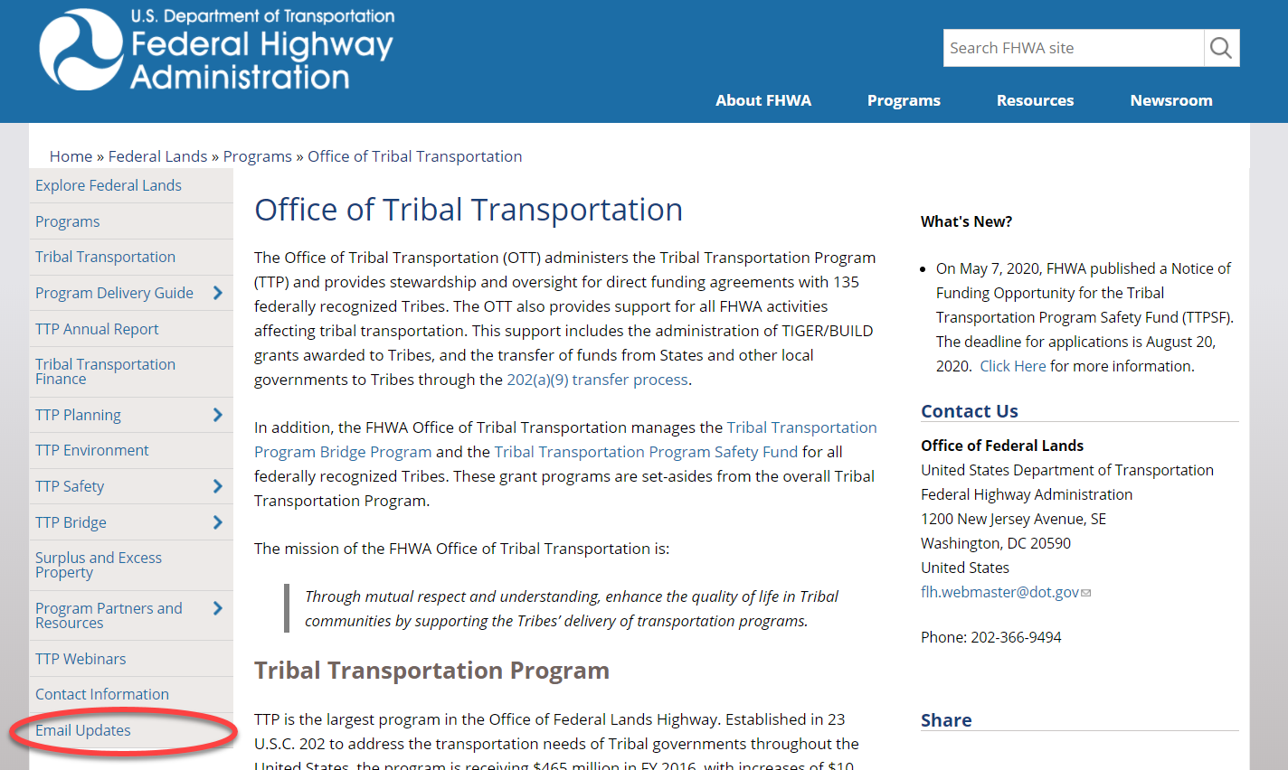
EMAIL LIST SERVE
https://highways.dot.gov/federal-lands/programs-tribal

Slide 15
Questions
Erin Kenley erin.kenley@dot.gov
(202) 309-9908

